Slide 1


Scaling AI with Mixture-of-Experts: Advances in Sparse Neural Networks and Efficient Training
Akul Gupta & Aditi Roy & Shraddhaa Mohan

Slide 2


Introduction
Background and Context
Modern advancements in large language models (LLMs) are mostly a product of scaling laws. As we increase the size of the underlying model, we see a smooth increase in performance (assuming that the model is trained over a sufficiently large dataset). However, scaling up dense LLMs to a larger number of parameters leads to exponential increases in energy consumption, memory usage, and training time.
The Solution ?
GRAINGER ENGINEERING
Notes:
Such scaling laws eventually led us to the creation of GPT-3, as well as other (more powerful) LLMs that followed it.
As a result, compute and data have become the primary bottleneck for training better LLMs—creating a better model is relatively simple given access to more compute and data.
As the training of giant dense models hits the boundary on the availability and capability of the hardware resources today, Mixture-of-Experts (MoE) models have become one of the most promising model architectures due to their significant training cost reduction compared to quality equivalent dense models.”
Given a fixed computing budget, training a larger model for fewer steps is better than training a smaller model for more steps.

Slide 3
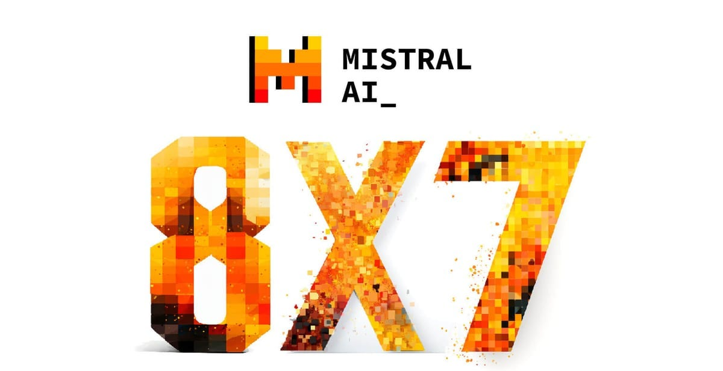


Introduction
What is Mixture of Experts (MoE)?
Mixture of Experts is a modelling technique that enables large-scale models, even those comprising many billions of parameters. They greatly reduce computation costs during pre-training and achieve faster performance during inference time.
How do they do it?
Efficiency is achieved through selectively activating only the specific experts
needed for a given task, rather than activating the entire neural network
for every task.
This technique has been used in some leading large language models (LLMs) like
Mistral’s Mixtral 8x7B, Google’s Switch Transformer and (according to some reports)
OpenAI’s GPT-4, have employed MoE architecture.
GRAINGER ENGINEERING
Notes:
Rather than activating the whole network for every input, different parts of the model are activated for different inputs

Slide 4
Introduction
Outline
To understand MoE models better, this presentation will walk you through two papers:
Outrageously Large Neural Networks: The Sparsely-Gated Mixture-of-Experts Layer: This paper explores the foundational MoE architecture and the concept of sparse gating.
DeepSpeed-MoE: Advancing Mixture-of-Experts Inference and Training to Power Next-Generation AI Scale: This paper focuses on the system-level optimizations that make the training and inference of these large MoE models more efficient at scale.
And we go through some exciting new directions at the end as well!
GRAINGER ENGINEERING

Slide 5
Outrageously Large Neural Networks: The Sparsely-Gated Mixture-of-Experts Layer
Akul Gupta & Aditi Roy & Shraddhaa Mohan

Slide 6
Outrageously Large Neural Networks: The Sparsely-Gated MoE Layer
Key Contributions
Achieved greater than 1000x improvements in model capacity with only minor losses in computational efficiency on modern GPU clusters.
Introduce a Sparsely-Gated Mixture-of-Experts layer (MoE), consisting of up to thousands of feed-forward sub-networks along with a trainable gating network that determines a sparse combination of experts to use for each example.
Shows a model architecture in which a MoE with up to 137 billion parameters is applied convolutionally between stacked LSTM layers to do text processing (and translation).
GRAINGER ENGINEERING

Slide 7
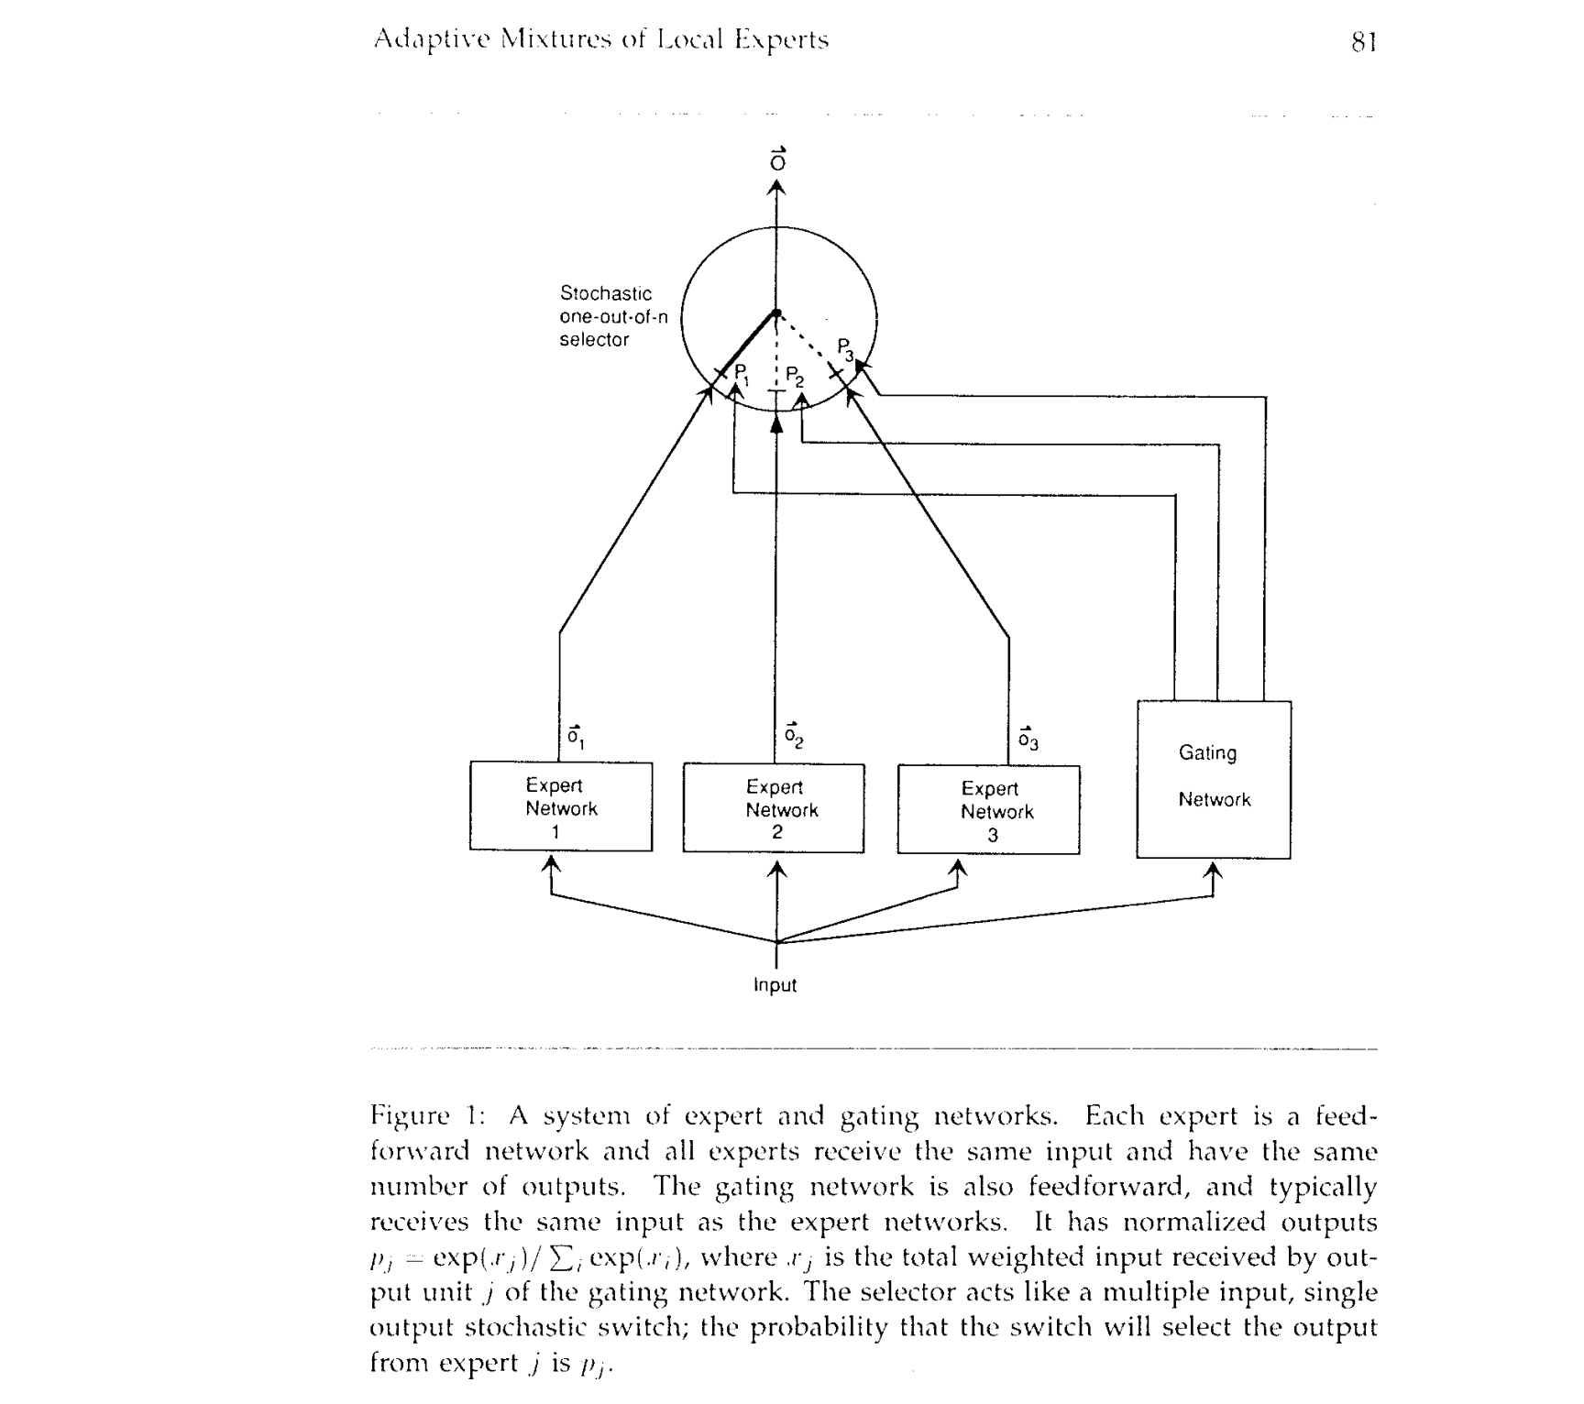
Outrageously Large Neural Networks: The Sparsely-Gated MoE Layer
Brief History of MoEs
The roots of MoEs come from the 1991 paper Adaptive Mixture of Local Experts.
The idea, akin to ensemble methods, was to have a supervised procedure for a system composed of separate networks, each handling a different subset of the training cases. Each separate network, or expert, specializes in a different region of the input space.
How is the expert chosen?
A gating network determines the weights for each expert. During training, both the expert and the gating are trained.
GRAINGER ENGINEERING
Notes:
Given a fixed computing budget, training a larger model for fewer steps is better than training a smaller model for more steps. In particular, a MoE model should achieve the same quality as its dense counterpart much faster during pretraining.
The key idea here is that rather than activating the whole network for every single input, different parts of the model are activated for different inputs.
This idea has its roots in research on conditional computation in the early 1990s and allows us to train massive models in a tractable manner, which is helpful in domains—such as language modeling—that benefit from models with extra capacity.

Slide 8
Outrageously Large Neural Networks: The Sparsely-Gated MoE Layer
Brief History of MoEs
Between 2010-2015, two different research areas contributed to later MoE advancement:
Experts as components: In the traditional MoE setup, the whole system comprises a gating network and multiple experts. MoEs as the whole model have been explored in SVMs, Gaussian Processes, and other methods. The work by Eigen and others explored MoEs as components of deeper networks. This allows having MoEs as layers in a multilayer network, making it possible for the model to be both large and efficient simultaneously.
Conditional Computation: Traditional networks process all input data through every layer. In this period,
Yoshua Bengio researched approaches to dynamically activate or deactivate components based on the input
token.
These works led to exploring a mixture of experts in the context of NLP.
GRAINGER ENGINEERING
Notes:
Given a fixed computing budget, training a larger model for fewer steps is better than training a smaller model for more steps. In particular, a MoE model should achieve the same quality as its dense counterpart much faster during pretraining.
The key idea here is that rather than activating the whole network for every single input, different parts of the model are activated for different inputs.
This idea has its roots in research on conditional computation in the early 1990s and allows us to train massive models in a tractable manner, which is helpful in domains—such as language modeling—that benefit from models with extra capacity.

Slide 9
Outrageously Large Neural Networks: The Sparsely-Gated MoE Layer
Challenges Addressed
Arithmetic vs. Branching Speed
GPUs excel at arithmetic but are slower at branching (i.e., a major component of conditional computation). MoE uses sparse activation, turning on/off large network chunks based on gating decisions.
Batch Size Constraints
Large batch sizes are essential for efficiency. Conditional computation reduces batch size for the active network parts, affecting performance.
Network Bandwidth Bottlenecks
GPU clusters have high computational power but limited inter-device bandwidth. Algorithms must balance computation and network communication demands. Embedding layers suffer from bandwidth limitations.
Sparsity and Load-Balancing Additional loss terms are often required to maintain sparsity and balance load across experts,
impacting both model quality and efficiency.
Scaling to Large Data Sets
Training MoE models on small datasets limits their potential. Small datasets cannot provide adequate signal to train models with millions, let alone billions of parameters.
GRAINGER ENGINEERING
Notes:
Although work in [1] was one of the first to apply MoEs to language modeling, the idea of an MoE dates back to the early 1990s. With this in mind, we might wonder: What prevented MoEs from being more widely adopted?

Slide 10
Outrageously Large Neural Networks: The Sparsely-Gated MoE Layer
What is a Sparse MoE?
The paper introduces a new type of general purpose neural network component: a Sparsely-Gated Mixture-of-Experts Layer (MoE). This is a generic neural network module with two components:
Experts: Each layer has several “experts” that are standalone neural network modules or layers with independent sets of parameters.
Router: a parametric (and learnable) gating mechanism that selects a (sparse) group of experts used to process each input.
In this paper, each expert within an MoE is a feed-forward neural network with an identical architecture. However, more complex architectures could be used; e.g., we can even create “hierarchical” MoE modules by implementing each expert as another MoE! Both the experts and the gating mechanism are jointly trained along with other network parameters via gradient descent.
GRAINGER ENGINEERING
Notes:
The work builds on this use of MoEs as a general purpose neural network component. The convolutional application of the MoE allows for different gating decisions at each position in the text.
We can send a token to more than one expert. How to route a token to an expert is one of the big decisions when working with MoEs

Slide 11
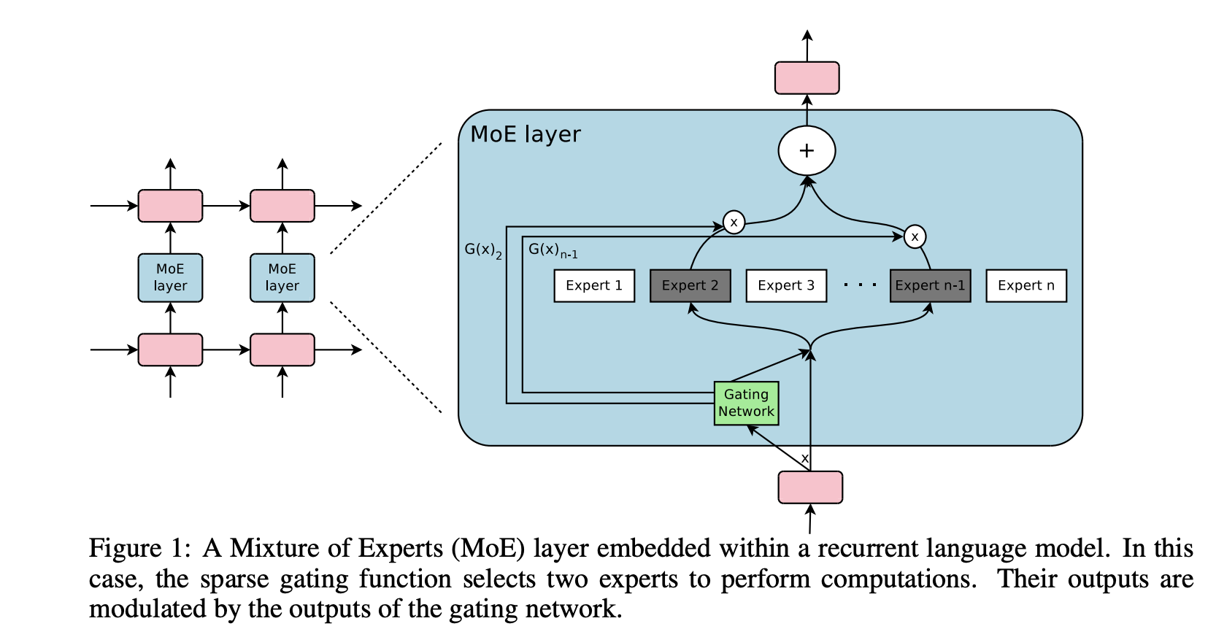
Outrageously Large Neural Networks: The Sparsely-Gated MoE Layer
Structure of the MoE Layer
CHART / GRAPH
GRAINGER ENGINEERING

Slide 12
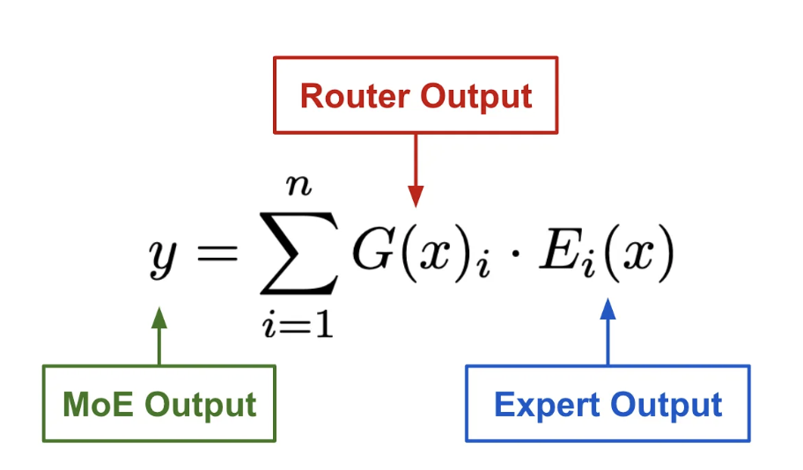
Outrageously Large Neural Networks: The Sparsely-Gated MoE Layer
Computing the output of an MoE module
A learned gating network (G) decides which experts (E) to send a part of the input. The gating network or router outputs a sparse n-dimensional vector (n is the number of experts).
The router’s output is sparse—experts that receive a weight of zero are no longer considered when computing the output of an MoE so we save compute!
If the number of experts is very large, we can reduce the branching factor by using a two-level hierarchical MoE. In a hierarchical MoE, a primary gating network chooses a sparse weighted combination of “experts", each of which is itself a secondary mixture-of-experts with its own gating network.
GRAINGER ENGINEERING

Slide 13
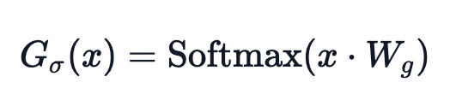
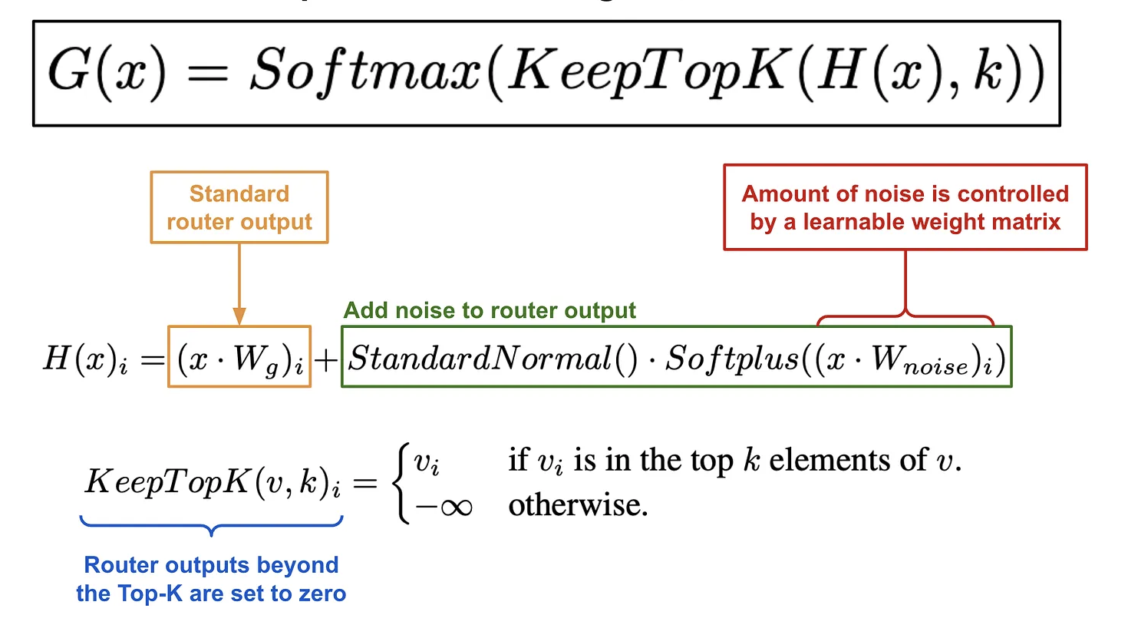
Outrageously Large Neural Networks: The Sparsely-Gated MoE Layer
Gating Mechanism
Many different strategies have been proposed for routing within an MoE. The simplest approach would be to multiply our input by a weight matrix and apply softmax:
The issue with this approach is that it does not guarantee that the selection of experts will be sparse. To solve for this the authors propose a modified gating mechanism that adds sparsity and noise to this simplistic softmax gating mechanism.
Sparsity: All but the output of the top-K experts are masked (i.e., set to -∞) to ensure that the selection of experts is sparse.
Noise: An adjustable amount of Gaussian noise is added to the output of the router prior to applying softmax. (We need this for load balancing!)
GRAINGER ENGINEERING

Slide 14
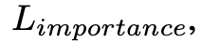
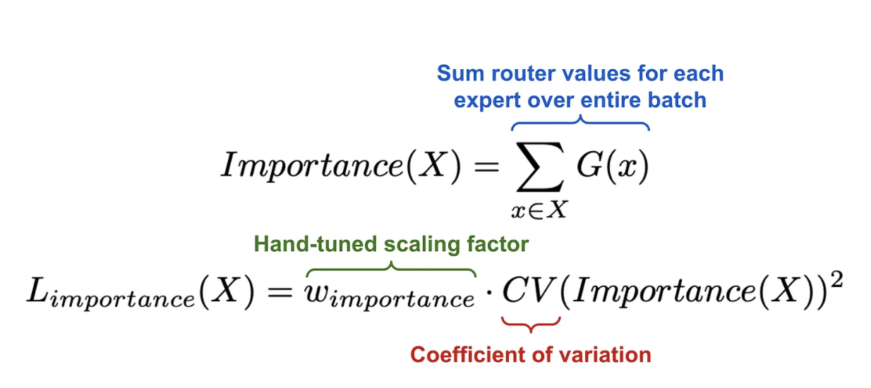
Outrageously Large Neural Networks: The Sparsely-Gated MoE Layer
Load Balancing
One issue with MoEs is that the network has a tendency to repeatedly utilize the same few experts during training. Instead of learning to use all experts uniformly, the gating mechanism will converge to a state that always selects the same set of experts for every input. This is a self-fulfilling loop—if one expert is selected most frequently, it will be trained more rapidly and, therefore, continue to be selected over the other experts!
Apart from adding noise to the standard router output, the authors define an additional loss which is added to the overall loss function for the model.
GRAINGER ENGINEERING
Notes:
Experts can be balanced by adding a simple “soft” constraint to the training loss. Put simply, experts that are selected frequently in the batch will have a high importance score.
If experts all have very similar importance scores, the CV will be small and vice versa.
While this loss function can ensure equal importance, experts may still receive very different numbers of examples. For example, one expert may receive a few examples with large weights, and another may receive many examples with small weights. This can cause memory and performance problems on distributed hardware. To solve this problem, we introduce a second loss function, Lload , which ensures balanced loads.

Slide 15
Outrageously Large Neural Networks: The Sparsely-Gated MoE Layer
Load Balancing
We define “Importance” score for each expert over a batch of input data, which can be computed by taking a sum over the gate values for each expert across the batch.
Then, we can compute an auxiliary loss function by taking the squared coefficient of variation (CV) of expert importance scores. This loss term can be added to the model’s training objective to encourage experts to receive equal importance within each batch.
GRAINGER ENGINEERING
Notes:
Experts can be balanced by adding a simple “soft” constraint to the training loss. Put simply, experts that are selected frequently in the batch will have a high importance score.
If experts all have very similar importance scores, the CV will be small and vice versa.
While this loss function can ensure equal importance, experts may still receive very different numbers of examples. For example, one expert may receive a few examples with large weights, and another may receive many examples with small weights. This can cause memory and performance problems on distributed hardware. To solve this problem, we introduce a second loss function, Lload , which ensures balanced loads.

Slide 16
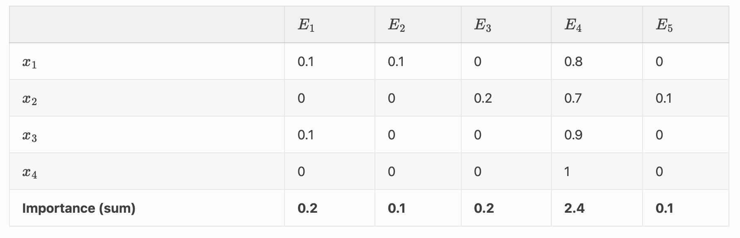
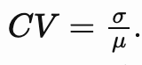
Outrageously Large Neural Networks: The Sparsely-Gated MoE Layer
Load Balancing
As an example, take a batch of 4 samples assigned across 5 experts , with the following distribution:
In this example, the mean of the importance is 0.6, and standard deviation is 0.9, thus the CV is 0.667. If experts would be assigned a similar importance, then the variance would’ve been smaller and the CV also smaller, thus reducing the importance loss.
GRAINGER ENGINEERING
Notes:
Experts can be balanced by adding a simple “soft” constraint to the training loss. Put simply, experts that are selected frequently in the batch will have a high importance score.
If experts all have very similar importance scores, the CV will be small and vice versa.
While this loss function can ensure equal importance, experts may still receive very different numbers of examples. For example, one expert may receive a few examples with large weights, and another may receive many examples with small weights. This can cause memory and performance problems on distributed hardware. To solve this problem, we introduce a second loss function, Lload , which ensures balanced loads.

Slide 17
Outrageously Large Neural Networks: The Sparsely-Gated MoE Layer
Addressing Performance Challenges
Shrinking Batch Sizes As the number of experts (k) increases, each expert receives a smaller batch size, which hurts computational efficiency. For a batch size of b and n experts, each expert gets k*b/n examples, causing inefficiency in large-scale MoE models.
The solution?
Make original batch size as large as possible. However, there are memory limitations when scaling the batch size, especially since memory is required to store activations during both the forward and backward passes of training.
The paper suggests the following ways to increase batch sizes: - Mixing Data and Model Parallelism
- Taking advantage of Convolutionality
GRAINGER ENGINEERING
Notes:
The solution to this shrinking batch problem is to make the original batch size as large as possible. However, batch size tends to be limited by the memory necessary to store activations between the forwards and backwards passes.

Slide 18
Outrageously Large Neural Networks: The Sparsely-Gated MoE Layer
Mixing Data and Model Parallelism
Distribute the standard layers of the model and the gating network according to conventional data-parallel schemes, but keep only one shared copy of each expert.
Each expert in the MoE layer receives a combined batch consisting of the relevant examples from all of the data-parallel input batches.
This effectively increases the batch size for each expert by a factor of d (the number of devices).
Example: If the model is distributed across d devices, and each device processes a batch of size b, the
batch size each expert receives becomes approximately kbd/n, significantly improving efficiency.
In hierarchical MoE models, you can use data parallelism for the primary gating network, and model parallelism for the secondary MoE layers. This way, the experts in the secondary layers reside on different devices, allowing further scalability.
The total batch size increases, keeping the batch size per expert constant. The memory and bandwidth requirements per device also remain constant, as do the step times.
GRAINGER ENGINEERING
Notes:
This technique allows us to increase the number of experts (and hence the number of parameters) by proportionally increasing the number of devices in the training cluster. The total batch size increases, keeping the batch size per expert constant. The memory and bandwidth requirements per device also remain constant, as do the step times, as does the amount of time necessary to process a number of training examples equal to the number of parameters in the model

Slide 19
Outrageously Large Neural Networks: The Sparsely-Gated MoE Layer
Taking Advantage of Convolutionality
The same MoE is applied to each time step of the previous layer. If we wait for the previous layer to finish, we can apply the MoE to all the time steps together as one big batch. Doing so increases the size of the input batch to the MoE layer by a factor of the number of unrolled time steps.
Increasing the batch size for a recurrent MoE using the above trick does not work, because each time step’s output depends on the previous time step’s output. You can’t process multiple time steps in parallel since you need to finish one before moving on to the next.
GRAINGER ENGINEERING

Slide 20
Outrageously Large Neural Networks: The Sparsely-Gated MoE Layer
Addressing Performance Challenges
Network Bandwidth
When using multiple GPUs in a distributed system, one major bottleneck is network bandwidth—the speed at which data can be transferred between devices. If too much time is spent transferring data between devices, the benefit of fast computation is lost.
For efficient computation, the ratio of an expert’s computational workload (the amount of work done within the expert) to the size of the input and output data being sent across the network must be high.
We can get each expert to do more work by simply increasing the number of hidden layers or the size of the hidden layers.
GRAINGER ENGINEERING
Notes:
Each expert in the Mixture-of-Experts (MoE) layer is distributed across different devices, and the inputs and outputs of these experts need to be sent over the network.

Slide 21
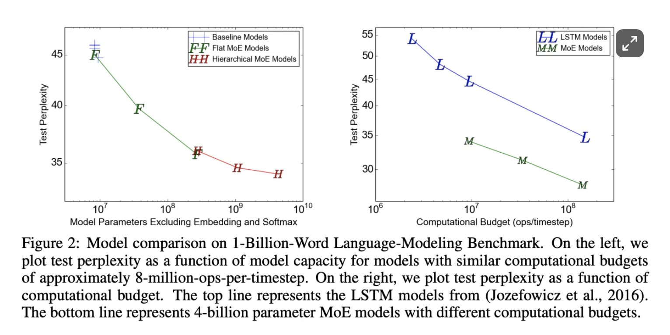
Outrageously Large Neural Networks: The Sparsely-Gated MoE Layer
Experiments
1 BILLION WORD LANGUAGE MODELING BENCHMARK
To test the performance of their sparse MoE layer, the authors in train a language model that inserts an MoE module between stacked layers of an LSTM. Both flat and hierarchical MoEs are tested with varying numbers of experts, and all models are trained such that their total computational cost is roughly equal
GRAINGER ENGINEERING
Notes:
Even when studying the smallest dataset, we see that the largest of the MoE models yields a noticeable improvement in perplexity (lower is better); see above.
The model with 4 always-active experts performed (unsurprisingly) similarly to the computationally-matched baseline models
On the 1-billion-word corpus, adding additional capacity seems to produce diminishing returns as the number of parameters in the MoE layer exceeds 1 billion, as can be seen in Figure 2-left.

Slide 22
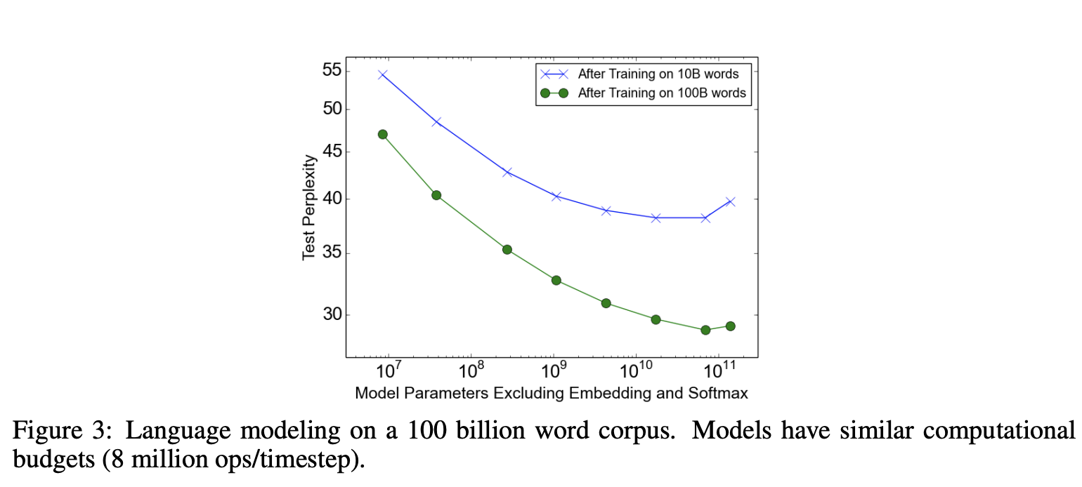
Outrageously Large Neural Networks: The Sparsely-Gated MoE Layer
Experiments
100 BILLION WORD GOOGLE NEWS CORPUS
GRAINGER ENGINEERING
Notes:
Figure 3 shows test perplexity as a function of capacity after training on 10 billion words (top line) and 100 billion words (bottom line). When training over the full 100 billion words, test perplexity improves significantly up to 65536 experts (68 billion parameters), dropping 39% lower than the computationally matched baseline, but degrades at 131072 experts, possibly a result of too much sparsity. The widening gap between the two lines demonstrates (unsurprisingly) that increased model capacity helps more on larger training sets. Even at 65536 experts (99.994% layer sparsity), computational efficiency for the model stays at a respectable 0.72 TFLOPS/GPU.

Slide 23
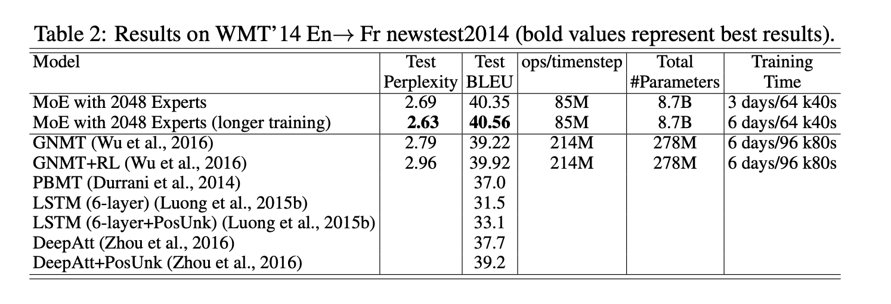
Outrageously Large Neural Networks: The Sparsely-Gated MoE Layer
Experiments
MACHINE TRANSLATION (SINGLE LANGUAGE PAIR)
Single-language machine translation aims to translate between one source and one target language.
The authors use a modified GNMT model with MoE layers that had 2056 experts each with about 2 million parameters, adding a total of 8 billion parameters to the model.
GRAINGER ENGINEERING

Slide 24
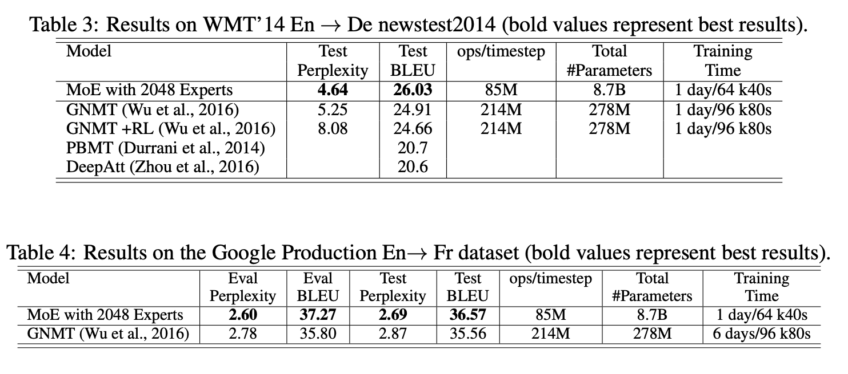
Outrageously Large Neural Networks: The Sparsely-Gated MoE Layer
Experiments
MACHINE TRANSLATION (SINGLE LANGUAGE PAIR)
GRAINGER ENGINEERING
Notes:
As our models did not use RL refinement, these results constitute significant gains of 1.34 and 1.12 BLEU score on top of the strong baselines in (Wu et al., 2016). The perplexity scores are also better.2 On the Google Production dataset, our model achieved 1.01 higher test BLEU score even after training for only one sixth of the time.

Slide 25
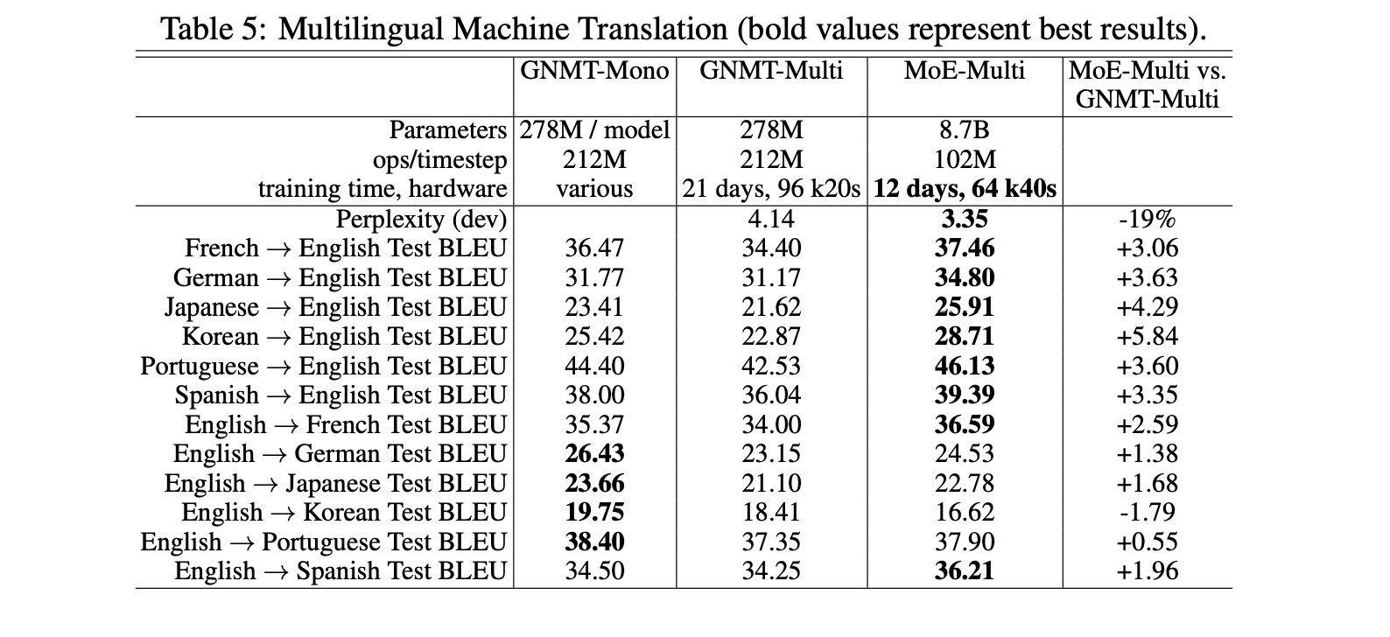
Outrageously Large Neural Networks: The Sparsely-Gated MoE Layer
Experiments
MULTILINGUAL MACHINE TRANSLATION
GRAINGER ENGINEERING
Notes:
Results: Results for the single-pair GNMT models, the multilingual GNMT model and the multilingual MoE model are given in Table 5. The MoE model achieves 19% lower perplexity on the dev set than the multilingual GNMT model. On BLEU score, the MoE model significantly beats the multilingual GNMT model on 11 of the 12 language pairs (by as much as 5.84 points), and even beats the monolingual GNMT models on 8 of 12 language pairs. The poor performance on English → Korean seems to be a result of severe overtraining, as for the rarer language pairs a small number of real examples were highly oversampled in the training corpus.

Slide 26
Outrageously Large Neural Networks: The Sparsely-Gated MoE Layer
Pros and Cons of Mixture of Experts (MoE)
Pros:
Faster Pretraining - They enable models to be pre-trained with far less compute, which means you can dramatically scale up the model or dataset size with the same compute budget as a dense model.
Faster Inference - Although a MoE might have many parameters, only some of them are used during inference. This leads to much faster inference compared to a dense model with the same number of parameters.
Cons:
High VRAM Usage - Since all parameters need to be loaded in RAM, so memory requirements are high.
Fine Tuning Challenges - They have historically struggled to generalize, leading to overfitting.
GRAINGER ENGINEERING
Notes:
All things considered, the choice of whether to use an MoE or not is highly application dependent. If we have nearly unlimited amounts of training data, as is true of most modern language models, then MoEs are highly beneficial and allow us to scale up our model’s capacity significantly, even beyond hardware-imposed limits. In smaller scale applications, however, MoEs are less straightforward to apply compared to dense models and could even perform worse!

Slide 27
DeepSpeed-MoE: Advancing Mixture-of-Experts Inference and Training to Power Next-Generation AI Scale
Akul Gupta & Aditi Roy & Shraddhaa Mohan

Slide 28
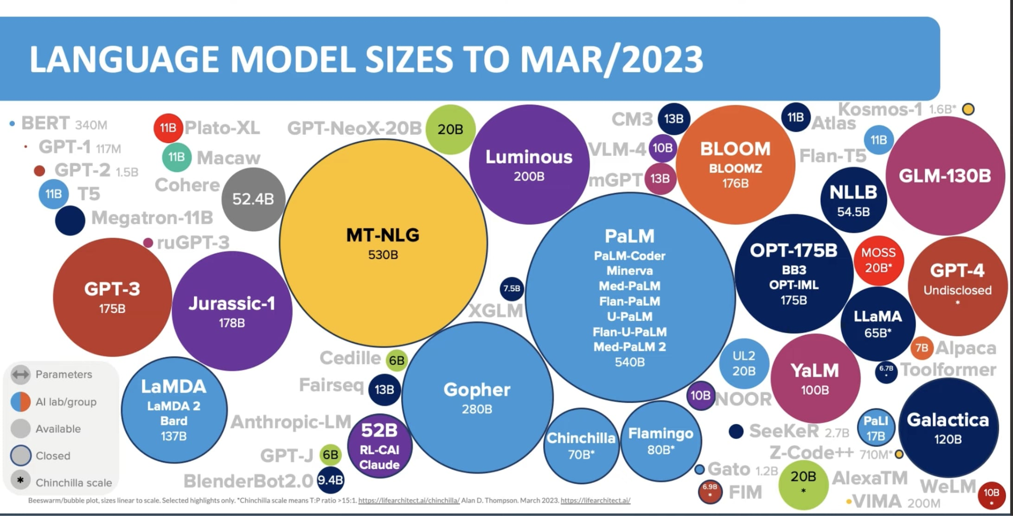
Why MoE?
As mentioned previously, there has been a trend of larger model sizes and consequently, improved model quality. However, sustaining the rapidly growing size of models is getting more and more difficult. This leads us to the question:
“Is it possible to produce model with similar quality using 3 to 5 times less resources?
GRAINGER ENGINEERING

Slide 29

Why MoE?
Why Mixture of Experts?
MoE based architecture is promising, enabling reduced compute requirements with respect to model parameters.
MoE also allows improved model quality without increasing
training cost.
However, MoE based models come with their own set of limitations and challenges in real world applications.
GRAINGER ENGINEERING

Slide 30
MoE Drawbacks
Limited Scope
MoE models in NLP are mostly used for encoder-decoder and sequence-to-sequence tasks.
Limited exploration in other areas.
Application in auto-regressive NLG tasks like GPT-3 and MT-NLG 530B is underexplored.
Training costs for auto-regressive models are significantly higher than for encoder-decoder models.
GRAINGER ENGINEERING

Slide 31
MoE Drawbacks
Enormous Memory Requirements
MoE based models have a much lower “parameter efficiency” compared to quality-equivalent dense models.
For training, the increase in model size requires a proportional increase in device memory
This massive model size makes MoE based model training at scale challenging due to both the device memory required as well as the system support required to effectively utilize the device memory across thousands of GPUs.
For example:
T5-large | MoE based Switch-Base model
0.74B parameters | 7.4B parameters
Can fit in the memory of a single 32GB V100 GPU | Requires at least 8-10 such GPUs to just fit the model in device memory for training
MT-NLG equivalent with 500B parameters | Over 5 trillion parameters which would require over 5K GPUs to fit the model states for training
GRAINGER ENGINEERING
Notes:
MoE based models have a much lower “parameter efficiency” compared to quality-equivalent dense models. Although MoE models require less compute, they require a significantly larger amount of number parameters.
For training, the increase in model size requires a proportional increase in device memory
Ex. MoE based Switch-Base model has 10x more parameters than T5-large (7.4B vs 0.74B) and still it does not have the same model quality when compared across a wide range of downstream tasks. T5-large can fit in the memory of a single 32GB V100 GPU, while training Switch-Base requires at least 8-10 such GPUs to even just fit the model in device memory for training. If we scale the dense model size to MT-NLG equivalent with 500B parameters, achieving similar quality with MoE based model might need a model with over 5 trillion parameters which would require over 5K GPUs to just fit the model states for training.

Slide 32
MoE Drawbacks
Limited Inference
Fast inference of MoE based models is difficult as a result of the large model size and poor parameter efficiency.
Multi-GPU inference technology is not designed to work with MoE models and the larger parameter size needs more GPUs to fit.
Inference is often memory bandwidth bound so MoE based models could require 10x higher achievable memory bandwidth to achieve similar inference latency as the dense models, since MoE models can be 10x larger than their dense equivalent,.
GRAINGER ENGINEERING

Slide 33
Solutions?
GRAINGER ENGINEERING
Notes:
Despite the promising and non-trivial reduction in training cost, these challenges severely limits the practical applicability of MoE. In an effort to make MoE practical, accessible and applicable, we will discuss three corresponding solutions

Slide 34
MoE Proposed Solutions
Auto-regressive NLG Tasks:
MoE models achieve GPT-3 and MTNLG quality with 5x lower training cost.
Potential to reduce costs and improve next-gen model quality despite hardware limitations.
Pyramid-Residual MoE (PR-MoE):
Hybrid dense MoE model with residual connections, applying experts selectively.
Reduces parameter size by up to 3x without sacrificing quality or compute.
Mixture-of-Students (MoS): Cuts MoE model size by up to 3.7x using staged knowledge distillation.
DeepSpeed-MoE Inference System:
Highly optimized for scaling across hundreds of GPUs.
Reduces inference latency and cost by up to 7.3x.
Achieves under 25 ms latency for trillion-parameter MoE models.
Offers 4.5x faster and 9x cheaper inference compared to dense models of equivalent quality.
GRAINGER ENGINEERING
Notes:
Expand the scope of MoE based models to include auto-regressive NLG tasks and demonstrate 5x less training cost to achieve comparable model quality to GPT-3 and MTNLG. This shows clear opportunities to reduce the cost of training 2 large MLG models and to reach higher next generation model quality, given the limitations of current hardware.
Improve parameters efficiency of MoE based models by developing an architecture called Pyramid-Residual MoE (PR-MoE). This is a hybrid dense MoE model made using residual connecting, applying experts only where they are most effective.This can reduce parameter size by up to 3x with no reduction in model quality and little change in compute requirements. Also, a refined version, Mixture-of-Students (MoS), reduces MoE model size by up to 3.7x with comparable model quality, via staged knowledge distillation.
Development of DeepSpeed-MoE inference system, a highly optimized MoE inference system, enabling efficient scaling of inference workloads across hundreds of GPus. This provides up to 7.3x reduction in inference latency and cost (in comparison to existing MoE inference solutions).
It offers ultra-fast inference latencies (under 25 ms) for trillion-parameter MoE models. DeepSpeed-MoE also offers up to 4.5x faster and 9x cheaper inference for MoE models compared to quality-equivalent dense models by combining both system and model optimizations.

Slide 35
Related Work
Large Scale Dense NLP Models
Scaling Law in NLP Model Capacity
Exponential Growth: Pretrained NLP model sizes have increased by 10x annually over recent years to test scaling laws for model capacity.
Earlier Models (100M Parameters): BERT, XLNet, RoBERTa, ALBERT, GPT
Mid-Stage Models (Billions of Parameters): GPT-2, TuringNLG, Megatron-LM, T5
Showed improved performance on NLP tasks
GPT-3 (175B Parameters):
Achieved superior zero/few-shot learning, comparable to smaller models with fine-tuning.
Megatron-Turing NLG (530B Parameters):
Achieved state-of-the-art results in zero/few-shot learning with DeepSpeed and Megatron-LM.
Limitation: Training took 3 months on 2,000 A100 GPUs—scaling further is not feasible due to immense compute requirements.
GRAINGER ENGINEERING
Notes:
Related work that motivates the exploration of more efficient architecture like MoE
The rapid growth of dense models, like GPT-3 and Megatron-Turing NLG, have driven improvements in model quality. However, the increasing compute and memory requirements make further scaling impractical.

Slide 36
Related Work
Reducing Training Cost by MoE Architecture
Mixture of Experts (MoE): Reduces training cost by leveraging model sparsity, allowing large models without increased computation.
MoE in Action:
LSTM-MoE model: Scaled to 127B parameters for language modeling and translation.
GShard (600B): Trained MoE model cheaper than 100B dense model.
Switch Transformer (1.6T): 2.5x faster training speed than dense models.
MoE for Language Generation: Recent works show MoE is effective for auto-regressive NLP tasks.
DeepSpeed-MoE System:
Innovations: PR-MoE architecture and MoS knowledge distillation for efficient parameter usage.
Inference Efficiency: Achieves high throughput and ultra-low latency by optimizing model size, memory bandwidth, and data access.
GRAINGER ENGINEERING
Notes:
This section discusses how Mixture-of-Experts (MoE) models offer a promising solution by reducing the compute cost while maintaining model quality. The reduced training costs of MoE models address the growing inefficiencies of dense models.

Slide 37
Related Work
MoE Training and Inference Systems
Growing Adoption of MoE: Many open-source systems are being developed for MoE model training, though optimized systems for inference are still lacking.
Key MoE Training Systems:
DeepSpeed MoE:
Optimized for large-scale training with flexible API and parallelism strategies (tensor, data, expert).
Trained Z-code MoE (10B parameters) in 5x less time than a dense model.
FastMoE:
Research tool demonstrating MoE training with data and expert parallelism, but lacks end-to-end training results.
Fairseq-MoE:
Provides a generic MoE training pipeline.
Optimized by Tutel, achieving 40% faster performance.
GRAINGER ENGINEERING
Notes:
Finally, this section focuses on systems designed to support the training and inference of MoE models at scale. It highlights the need for optimized infrastructure to manage the large memory and compute requirements of MoE models, paving the way for innovations like DeepSpeed-MoE discussed in the paper.

Slide 38
DeepSpeed-MoE for NLG
DeepSpeed-MoE for NLG: Reducing the Training Cost of Language Models by 5 Times
Autoregressive NLG models excel at tasks like document summarization, headline generation, question answering, and even code generation.
However, their training requires significant compute and energy.
By using Mixture of Experts (MoE), we can either enhance model quality without increasing training costs or reduce training costs by 5x while maintaining the same performance as dense models.
GRAINGER ENGINEERING

Slide 39
DeepSpeed-MoE for NLG
MoE based NLG Model Architecture
Model Selection:
350M: 24 layers, 1024 hidden size, 16 attention heads
1.3B: 24 layers, 2048 hidden size, 16 attention heads
6.7B: 32 layers, 4096 hidden size, 32 attention heads
MoE Integration:
350M+MoE-128 & 1.3B+MoE-128:
Base models with 128 experts added on every other feedforward layer (12 MoE layers).
Gating Function:
Activates a subset of experts per token.
Top-1 Expert Selection: Matches computation cost of dense models.
Top-2 Gating: Improves convergence but adds significant overhead.
GRAINGER ENGINEERING
Notes:
To complete training in a reasonable timeframe, the following models are selected: 350M (24 layers, 1024 hidden size, 16 attention heads), 1.3B (24 layers, 2048 hidden size, 16 attention heads), and 6.7B (32 layers, 4096 hidden size, 32 attention heads).
We use “350M+MoE-128” to denote a MoE model that uses 350M dense model as the base model and adds 128 experts on every other feedforward layer. That is to say, there are in total 12 MoE layers for both 350M+MoE-128 and 1.3B+MoE-128.
We use a gating function to activate a subset of experts in the MoE layer for each token. Specifically, in our experiments, only the top-1 expert is selected. Therefore, during both training and inference, our MoE model will have the same number of parameters to be activated for each token as their dense part. For example, 1.3B+MoE128 will only activate 1.3B parameters per token, and the amount of training computation per token will be similar to a 1.3B dense model. We also tested top-2 gating function and found it provides some convergence improvement, but it is a diminishing return and it comes with a large training computation/communication overhead compared to top-1 gating

Slide 40
DeepSpeed-MoE for NLG
Training and Evaluation Settings
Pre-training Environment:
Conducted on 128 Ampere A100 GPUs (Azure ND A100 instances).
Leveraged optimized Azure HPC docker images with NCCL, Mellanox OFED, Sharp, and CUDA.
DeepSpeed:
Combines data parallel and expert parallel training to efficiently scale MoE models.
Training Data:
Used the same dataset as the MT-NLG model.
Both dense and MoE models trained on 300B tokens for fair comparison.
GRAINGER ENGINEERING

Slide 41
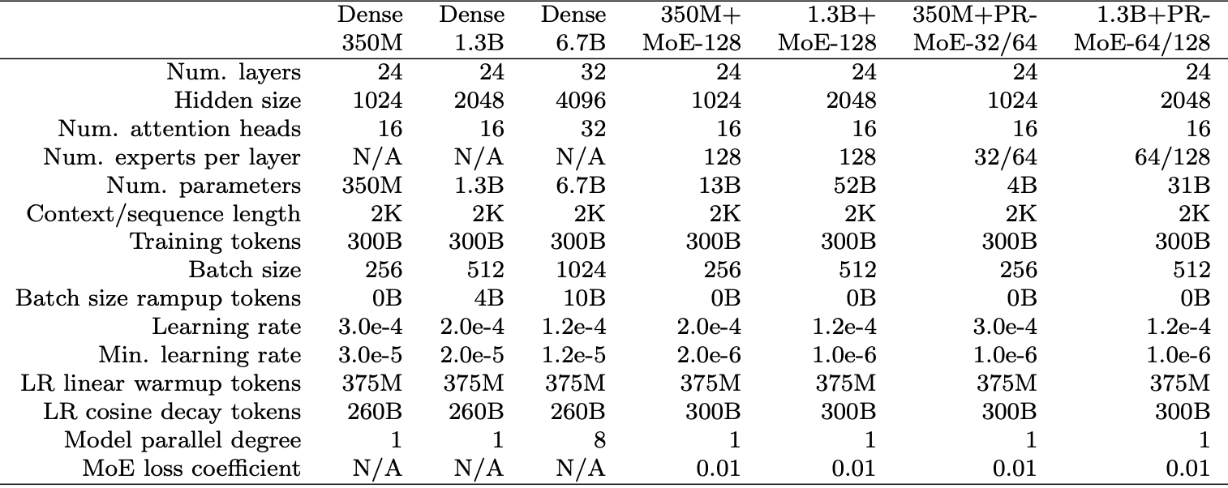
DeepSpeed-MoE for NLG
Training and Evaluation Settings
GRAINGER ENGINEERING
Notes:
Table summarizes the hyperparameters for training the dense and MoE models. For dense models we followed the hyperparameters from the GPT-3 work [22]. For MoE models, we find that using a lower learning rate and longer learning rate decay duration compared to the dense counter parts (e.g., dense 1.3B versus 1.3B+MoE-128) could provide better convergence. We believe that this is because MoE models have much larger number of parameters. MoE models have two additional hyperparameters: the number of experts per MoE layer, and a coefficient when adding the MoE layer losses to the total training loss. In addition to comparing the validation loss during pre-training, we employ 6 zero-shot evaluation tasks to compare the final model quality: 1 completion prediction task (LAMBADA [16]), 1 common sense reasoning task (PIQA [35]), 2 reading comprehension tasks (BoolQ [18], RACEh [36]), and 2 question answering tasks (TriviaQA [21], WebQs [20]).

Slide 42
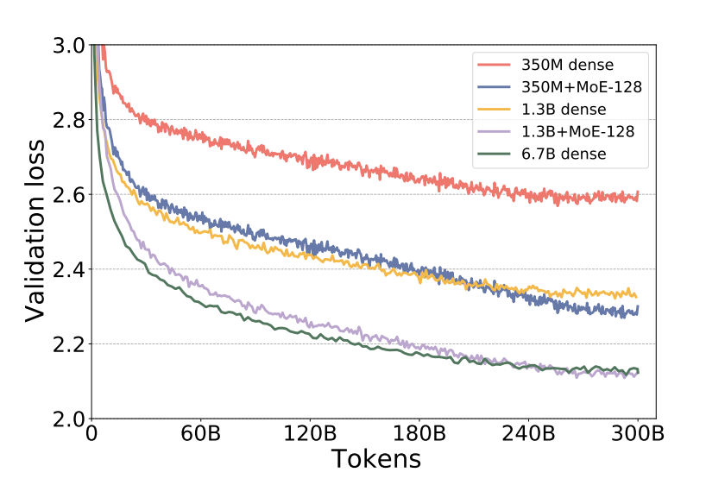
DeepSpeed-MoE for NLG
MoE Leads to Better Quality for NLG Models
MoE Models Show Superior Validation Loss:
350M+MoE-128 achieves validation loss on par with the 1.3B dense model (4x larger base).
1.3B+MoE-128 matches the validation loss of the 6.7B dense model (5x larger base).
GRAINGER ENGINEERING

Slide 43
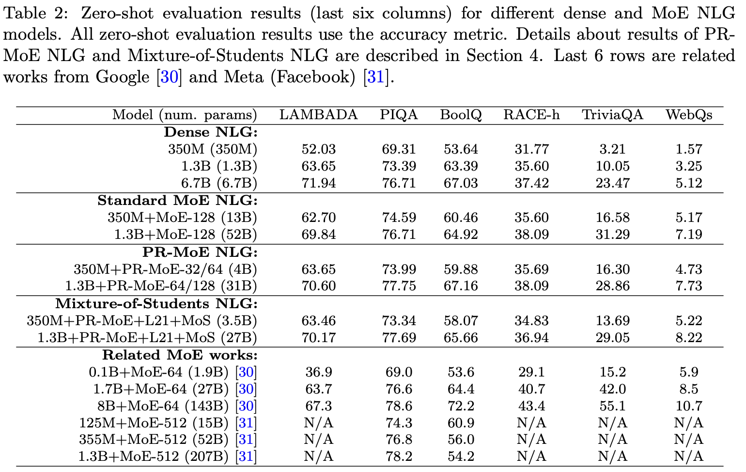
DeepSpeed-MoE for NLG
MoE Leads to Better Quality for NLG Models
GRAINGER ENGINEERING
Notes:
MoE Models: Zero-shot Evaluation & Efficiency
Model Quality:
MoE models perform on par with dense models in zero-shot evaluations across 6 downstream tasks.
MoE models match dense counterparts with 4-5x larger base in quality.
Comparison to Related Works:
LAMBADA:
Our MoE models achieve better accuracy with up to 5.3x fewer parameters compared to 8B+MoE-64 (143B).
PIQA/BoolQ:
Our MoE models outperform with up to 1.9x fewer parameters compared to 355M+MoE-512 (52B).

Slide 44
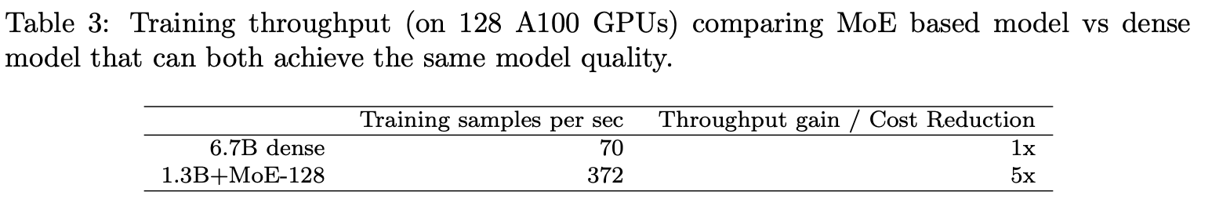
DeepSpeed-MoE for NLG
Same Quality with 5x Less Training Cost
Quality Improvement:
MoE with 128 experts enhances model quality without extra compute.
Efficiency:
1.3B+MoE-128 model: Comparable compute to 1.3B dense, with quality of 6.7B dense.
5x reduction in training compute.
Training Benefits:
Faster training and lower costs with DeepSpeed MoE.
Example: 1.3B+MoE-128 vs. 6.7B dense model on 128 NVIDIA A100 GPUs.
Future Potential:
MoE could enable training trillion-parameter models at 200B dense model costs, saving millions in training and energy.
GRAINGER ENGINEERING
Notes:
Summary:
MoE significantly cuts training costs and improves efficiency for large models.

Slide 45
PR-MoE: Pyramid-Residual-MoE
Key Questions in MoE Architectures:
Standard MoE architecture uses the same number and structure of experts in all layers.
Critical Question in machine learning:
Do all layers in a Deep Neural Network (DNN) learn the same representations?
In Computer Vision (CV):
Shallow layers (closer to inputs) learn general representations.
Deep layers (closer to outputs) learn more specific, objective-driven representations.
While this has been explored in CV, it is underexplored in Natural Language Processing (NLP), especially for MoE architectures.
GRAINGER ENGINEERING

Slide 46
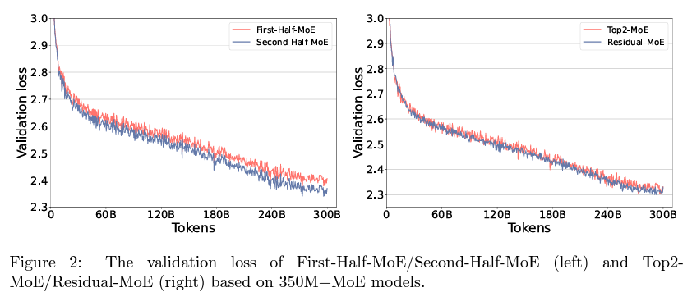
PR-MoE: Pyramid-Residual-MoE
Experiment: Half-MoE Architectures
Compared two 350M+MoE models:
First-Half-MoE: MoE layers in the first half, dense in the second.
Second-Half-MoE: MoE layers in the second half, dense in the first.
Key Results:
Second-Half-MoE outperforms First-Half-MoE significantly (Figure 2, left).
Confirms that MoE layers do not learn the same level of representations.
Deeper layers benefit more from a large number of experts.
Conclusion: Phenomenon- I
Phenomenon-I: Deeper layers benefit from more experts, enhancing model performance.
GRAINGER ENGINEERING

Slide 47
PR-MoE: Pyramid-Residual-MoE
Key Questions in MoE Architectures:
Generalization in MoE Models: Two Common Methods
Increase the number of experts:
Keeps expert capacity the same.
Issue: Increases memory requirements.
Double the expert capacity:
Slightly more computation (33% increase).
Issue: Doubles communication volume, slowing down training and inference.
Key Question
Can we maintain efficiency while improving generalization performance?
Larger expert capacity aids accuracy by correcting the “representation” of the first expert.
Does the first expert need to change every time?
Could we fix the first expert and vary only the second expert?
GRAINGER ENGINEERING

Slide 48
PR-MoE: Pyramid-Residual-MoE
Experiment: Top2-MoE vs. Residual-MoE
Top2-MoE: Doubling the capacity—two experts per token.
Residual-MoE: Fixing one expert and varying the second expert across different experts.
Token always passes through a dense MLP module and an expert from the MoE module.
The expert acts as an error correction term for the dense MLP module.
Final output: Addition of these two branches.
Results & Insights
Both Top2-MoE and Residual-MoE show on-par generalization performance (Figure 2, right).
Residual-MoE has a 10% faster training speed due to reduced communication volume.
Achieves the benefit of using 2 experts per layer with the same communication overhead as Top-1 gating.
Conclusion: Phenomenon-II
Residual-MoE provides an efficient alternative, achieving both performance gains and reduced training time.
GRAINGER ENGINEERING

Slide 49
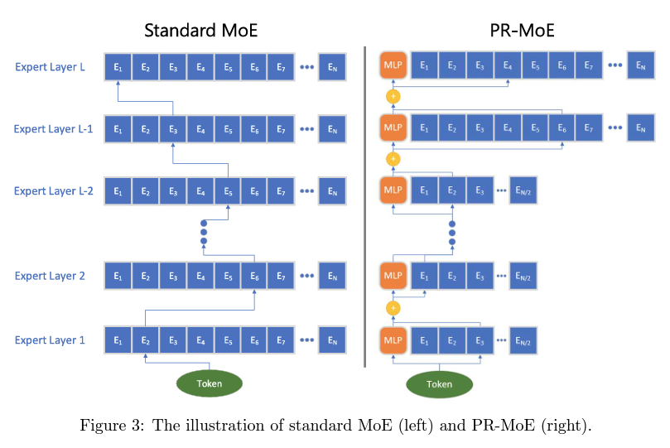
Pyramid Residual MoE Architecture
Pyramid-MoE Design
Inspired by Phenomenon-I, the Pyramid-MoE architecture utilizes:
More experts in the last layers compared to earlier layers.
Example: The last two layers have 2x experts as shown.
Residual-MoE Design
Based on Phenomenon-II, Residual-MoE:
Each token passes through one fixed MLP module and one chosen expert.
The MLP module (orange blocks) is used for error correction, reducing communication overhead.
Combining Pyramid-MoE and Residual-MoE: PR-MoE
Pyramid-Residual MoE (PR-MoE) integrates both designs:
Standard MoE layers are replaced by PR-MoE layers.
Combines the expert efficiency from Pyramid-MoE and error correction of Residual-MoE.
Conclusion: The new PR-MoE architecture balances expert utilization and communication efficiency for better performance.
GRAINGER ENGINEERING
Notes:
Based on the phenomena we are able to come up with various Architectures. The Pyramid-MoE design is inspired by Phenomenon-I, where more experts are allocated to the later layers of the model compared to the earlier ones. For example, the last two layers have twice as many experts. On the other hand, the Residual-MoE design is based on Phenomenon-II. In this approach, each token passes through both a fixed MLP module and one chosen expert. The fixed MLP, represented by the orange blocks, helps with error correction, reducing communication overhead. By combining these two designs, we arrive at the Pyramid-Residual MoE, or PR-MoE, where standard MoE layers are replaced by PR-MoE layers. This integration combines the expert efficiency from Pyramid-MoE with the error correction benefits of Residual-MoE.
An MLP module refers to a Multi-Layer Perceptron module, which is a type of feedforward artificial neural network.

Slide 50
Efficiently Training an MoE model
Challenges in MoE Training
Compute Efficiency: Requires a sufficiently large batch size for each expert.
Token Distribution Issue:
In MoE modules, the input tokens are partitioned across all experts.
Results in fewer tokens per expert compared to the rest of the model (where no such partitioning occurs).
Solution: Data Parallelism + Expert Parallelism
To address token reduction, use a combination of:
Data Parallelism: Increases the number of tokens in the batch.
Expert Parallelism: Match the number of experts with the number of parallelism units.
Benefits of Combined Parallelism
Increases aggregate tokens in the batch per MoE replica.
Ensures no reduction of tokens per expert when compared to the rest of the model.
Results in better compute efficiency across the MoE module.
GRAINGER ENGINEERING

Slide 51
Challenges of PR-MoE
Challenges of PR-MoE Training Infrastructure
Varying Number of Experts
PR-MoE models feature different numbers of experts at different stages, making it complex to determine an optimal expert parallelism strategy.
Optimal Expert Parallelism Complexity
The most efficient training approach for MoE models is to make expert parallelism equal to the number of experts.
However, PR-MoE’s varying expert numbers across layers prevent a single degree of expert parallelism from being optimal across all layers.
Expert Parallelism Trade-offs
Too Low (Smallest Number of Experts):
Forces multiple experts per GPU for layers with more experts.
Reduces batch size per expert.
Increases memory usage per GPU, leading to inefficiency.
Too High (Largest Number of Experts):
Creates load imbalance, where some GPUs have to process more experts than others.
Limits training throughput efficiency.
GRAINGER ENGINEERING
Notes:
Training PR-MoE models introduces several infrastructure challenges, particularly due to the varying number of experts across different layers. In traditional MoE models, the most efficient training approach is to align expert parallelism with the number of experts. However, PR-MoE’s differing expert counts across layers make it impossible to have a single, consistent degree of expert parallelism that works for all layers. This results in trade-offs. If the expert parallelism is set too low, multiple experts are forced to share a single GPU in layers with more experts. This reduces the batch size per expert and increases memory usage per GPU, leading to inefficiencies. On the other hand, if the expert parallelism is set too high, aligned with the largest number of experts, it creates load imbalances, where some GPUs handle more experts than others, limiting the overall training throughput efficiency.

Slide 52
DeepSpeed-MoE with Multi-expert and Multi-data Parallelism Support
Challenges:
Efficient training of models with multiple experts
Balancing parallelism and memory usage
Eliminating load-imbalance across GPUs
Solution: Flexible Parallelism Design
Developed on DeepSpeed-MoE
Supports training different model parts with varying degrees of:
Expert Parallelism
Data Parallelism
Outcomes:
No reduction in input tokens per expert
No load-imbalance or increased memory usage
Future-proof for various MoE models without training efficiency compromise
DeepSpeed-MoE can train PR-MoE models with any other future MoE variations that may require different experts at different stages of the model, without compromising on training efficiency or the memory requirements.
GRAINGER ENGINEERING
Notes:
The main challenges in training models with multiple experts include achieving efficient training, balancing parallelism with memory usage, and eliminating load imbalances across GPUs. To address these issues, we propose a flexible parallelism design, developed on DeepSpeed-MoE. This solution supports training different parts of the model with varying levels of expert and data parallelism. This design allows efficient training of any MoE models that may require different numbers of experts at various stages without compromising memory or efficiency.

Slide 53
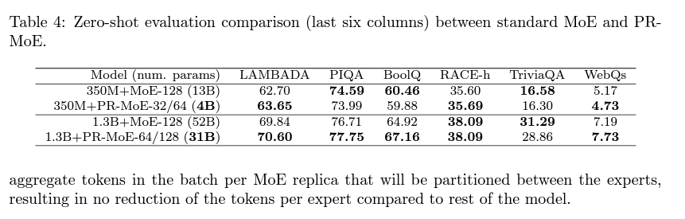
Evaluation of PR-MoE
PR-MoE architecture against Standard-MoE on Model Sizes 350M and 1.3B
Key Findings:
350M Model Case:
PR-MoE uses less than 1/3 of the parameters compared to Standard-MoE
Comparable accuracy achieved with significantly fewer parameters
1.3B Model Case:
PR-MoE utilizes about 60% of the parameters used by Standard-MoE
Similar accuracy despite parameter reduction
Performance Results:
PR-MoE achieves parameter efficiency without compromising accuracy
Enables more efficient scaling for large models
Conclusion:
PR-MoE provides a highly efficient alternative to Standard-MoE
Fewer parameters with comparable performance, beneficial for memory and computation constraints
GRAINGER ENGINEERING
Notes:
When comparing PR-MoE architecture to Standard-MoE across different model sizes, significant parameter efficiency is observed. In the case of the 350M model, PR-MoE uses less than one-third of the parameters required by Standard-MoE, while still achieving comparable accuracy. Similarly, for the 1.3B model, PR-MoE utilizes about 60% of the parameters used by Standard-MoE, again achieving similar accuracy despite the reduction in parameters. These results highlight that PR-MoE achieves parameter efficiency without compromising accuracy, making it particularly advantageous for scaling large models more efficiently. In conclusion, PR-MoE presents a highly efficient alternative to Standard-MoE, offering comparable performance with fewer parameters, which is especially beneficial for models operating under memory and computation constraints.

Slide 54
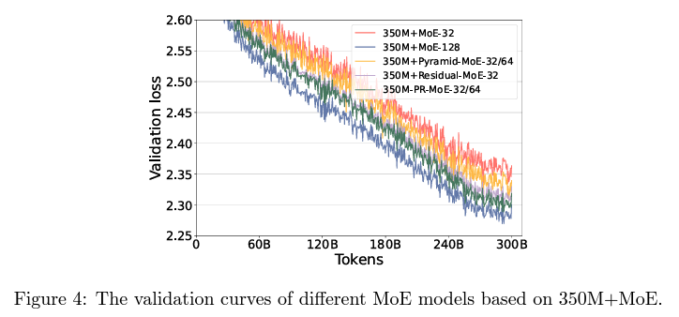
Ablation Study of Different MoE Architectures
Study the performance comparison of different MoE architectures:
Standard-MoE, Residual-MoE, Pyramid-MoE, PR-MoE (Combination of Pyramid and Residual)
Key Findings:
Validation Loss Gap Reduction:
Pyramid-MoE and Residual-MoE significantly reduce the validation loss gap between 350M+MoE-128 and 350M+MoE-32
PR-MoE further narrows the loss gap to ~0.01
PR-MoE demonstrates excellent parameter efficiency with minimal quality impact
Conclusion:
PR-MoE combines the strengths of Pyramid-MoE and Residual-MoE to provide superior performance with reduced parameter usage
Achieves near parity in validation loss compared to larger MoE architectures with fewer resources
GRAINGER ENGINEERING
Notes:
In a ablation study of different MoE architectures they we observed notable improvements in validation loss. Both Pyramid-MoE and Residual-MoE significantly reduce the validation loss gap and the PR-MoE further narrows this loss gap, showing exceptional parameter efficiency with minimal impact on model quality. In conclusion, PR-MoE successfully combines the strengths of Pyramid-MoE and Residual-MoE, delivering superior performance with fewer parameters abd achieving near parity in validation loss compared to larger MoE architectures, while utilizing fewer resources.

Slide 55
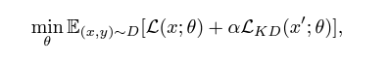
Mixture-of-Students via Staged KD
Layer Reduction via Knowledge Distillation (KD)
Compresses large models into smaller, more efficient ones
Reduces model size & computation with competitive results
Our Focus: KD for sparse MoE-based auto-generative LMs at multi-billion parameter scale
Preserves sparse fine-tuning and inference benefits
Comparison with Prior Works:
Prior studies convert MoE into dense models, losing MoE benefits
Current Study:
Smaller MoE models with KD can achieve similar performance on downstream tasks
Resulting models are lighter and faster during inference
Training Process:
Train a Teacher MoE Model
Student Model Creation:
Reduce depth of each expert branch in the teacher model to obtain a student.
Final student model retains sparsely gated architecture, but with smaller expert depth.
This student model is termed Mixture-of-Students (MoS).
Benefits of MoS:
Inherits sparse training & inference advantages of MoE.
Outperforms dense models with equivalent quality.
Knowledge Distillation (KD) Process:
The Mixture-of-Students (MoS) imitates the teacher MoE’s outputs:
Cross-entropy loss with hard labels.
KL divergence loss with soft labels from the teacher model
PR-MoS: Combining PR-MoE and KD:
PR-MoS achieves further reduction in model size while maintaining MoE’s sparse efficiency and performance with KD.
GRAINGER ENGINEERING
Notes:
KD Loss function where as a weight sum of the cross-entropy loss between predictions and the given hard label and the KL divergence loss between the predictions and the teacher’s soft label. Another approach that is further found for even smaller model size and inference is mixture of students via staged KD. Layer reduction is done here via Knowledge Distillation (KD), reducing both model size and computation while maintaining competitive results. The focus is on applying KD to sparse MoE-based auto-generative language models at the multi-billion parameter scale, preserving the benefits of sparse fine-tuning and inference. In comparison to prior studies that convert MoE into dense models and lose the advantages of sparsity, this approach shows that smaller MoE models distilled with KD can achieve similar performance on downstream tasks. These resulting models are lighter and faster during inference. The process begins by training a teacher MoE model, followed by the creation of a student model, where the depth of each expert branch is reduced. This student model, called the Mixture-of-Students (MoS), retains the architecture of the original but with smaller expert depth and inherits the sparse training and inference benefits of MoE and outperforming dense models of similar quality. During the KD process, the MoS imitates the teacher MoE’s outputs using cross-entropy loss with hard labels and KL divergence loss with soft labels from the teacher model. By combining PR-MoE with KD, PR-MoS achieves further reductions in model size while maintaining the efficiency and performance benefits of sparse MoE models through knowledge distillation.

Slide 56
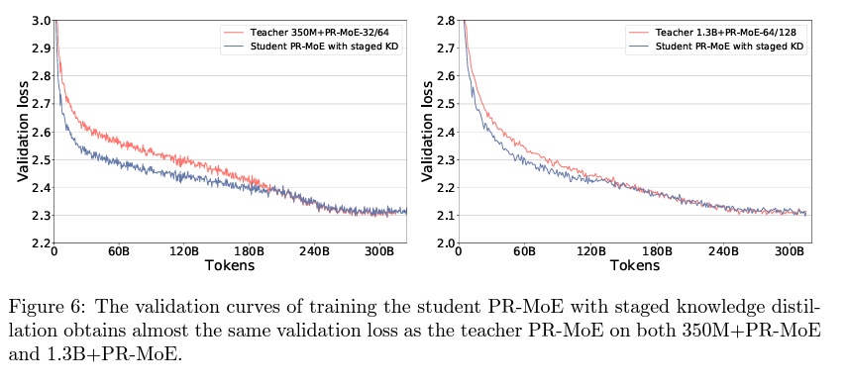
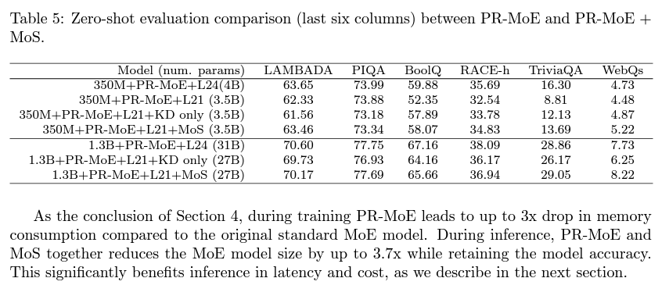
Evaluation of Mixture-of-Students
Student Models Configurations: Reduced depth to 12.5% (21 layers)
Pre-Training Convergence Results:
Staged-KD vs. Full-KD:
Validation Curves: Staged-KD student model shows a similar validation curve to the teacher model after 400K steps (see Figure 6).
Zero-Shot Evaluation: Staged-KD outperforms full-KD on downstream tasks.
Downstream Task Performance (Zero-Shot Evaluation):
Notable Accuracy Improvements with Staged-KD:
Small Accuracy Drop in PIQA task
Benefits of Staged-KD & MoS:
Memory Consumption: Up to 3x drop during training compared to standard MoE.
Inference Benefits:
Up to 3.7x smaller model size while maintaining accuracy.
Significant improvements in latency and cost-efficiency for inference.
Staged-KD effectively compresses PR-MoE models while retaining performance
GRAINGER ENGINEERING
Notes:
In their student model configurations, they reduce the model depth to 12.5%, resulting in 21 layers. When comparing pre-training convergence results between Staged-KD and Full-KD, the validation curves reveal that the Staged-KD student model closely follows the teacher model’s curve after 400K steps, as shown in Figure 6. In zero-shot evaluations, Staged-KD consistently outperforms Full-KD on downstream tasks, with only a small accuracy drop observed in the PIQA task. Staged-KD, along with the Mixture-of-Students (MoS) approach, provides several benefits, particularly in memory consumption, where it leads to up to a 3x reduction during training compared to standard MoE. For inference, Staged-KD results in a model that is up to 3.7x smaller, maintaining accuracy while delivering significant improvements in latency and cost-efficiency. Overall, Staged-KD effectively compresses PR-MoE models, preserving their performance while offering considerable efficiency gains.
Full Knowledge Distillation (Full-KD):
Process: In Full-KD, the student model is trained from scratch using the outputs of the teacher model throughout the entire training process. The teacher model's soft labels (probabilities) and sometimes hard labels are used to guide the student's learning from the beginning until the end.
Staged Knowledge Distillation (Staged-KD):
Process: Staged-KD takes a more incremental or "staged" approach. Instead of training the student model with the teacher's outputs from the start, the training process is divided into stages:
Initial Training: The student model is first trained on its own, often focusing on easier tasks or using basic labels.
Distillation Stage: After the initial training, the student model is gradually introduced to the teacher model's outputs (soft labels) in stages, allowing the student to distill the knowledge more progressively.
LAMBADA: +1.1 points, BoolQ: +6.5 points, RACE-h: +1.7 points, TriviaQA: +4.5 points

Slide 57
DeepSpeed-MoE Inference System
Key Achievements of DeepSpeed-MoE (DS-MoE)
7.3x better latency and lower cost compared to baseline MoE systems.
4.5x faster and 9x cheaper inference compared to dense models with similar quality.
DeepSpeed-MoE Design Goals
Steer performance toward the best-case scenario through well-coordinated optimizations:
Model Partitioning & Parallelism:
Group tokens with the same data path to minimize data access and maximize bandwidth.
Optimized Communication Scheduling:
Coordinate parallelism for effective token routing.
Kernel Optimizations:
Improve per-device performance, specifically for transformer and MoE layers.
GRAINGER ENGINEERING
Notes:
In the previous section, we presented PR-MoE and MoS to reduce the MoE model size while preserving the model accuracy. Now, we’ll look at DeepSpeed-MoE inference system to maximize the achievable memory bandwidth and interferencing at scale. DeepSpeed-MoE (DS-MoE) has efficiency improvements, delivering 7.3x better latency and significantly lower costs compared to baseline MoE systems. In addition, it offers 4.5x faster and 9x cheaper inference compared to dense models with similar quality. The design goals of DeepSpeed-MoE are focused on a series of optimizations, including partitioning and parallelism, Optimized communication scheduling and kernel optimizations.

Slide 58
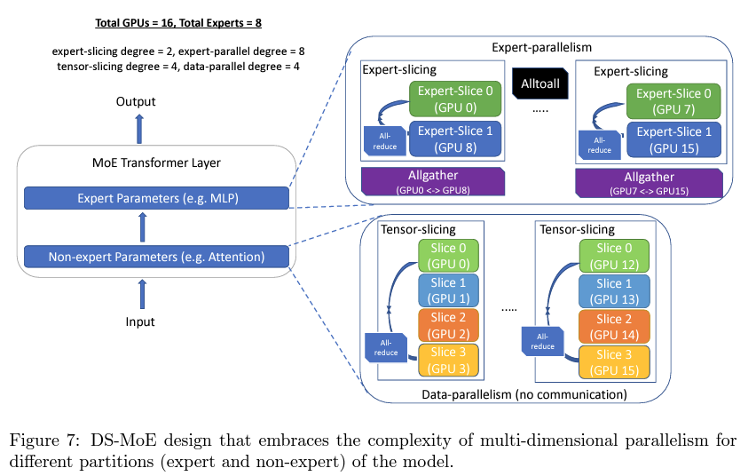
Flexible Combination of Tensor-Slicing, Expert-Slicing, Data Parallelism, and Expert Parallelism
Expert Parallelism & Expert-Slicing for MoE Parameters
Challenge: High Latency and Throughput in Batch Inference
Each token activates only one expert at each MoE layer.
Aggregate parameters needed for multiple tokens in batch inference can reach the full model size, increasing complexity.
Expert Parallelism: Maximizing Efficiency
Partition experts across devices to distribute token processing efficiently.
Group tokens assigned to the same expert to create critical data paths.
Parallelize token group processing across devices.
Expert-Slicing: Further Latency Optimization
Leverage tensor-slicing concepts to partition expert parameters horizontally or vertically across GPUs.
Provides an additional layer of parallelism for latency-critical scenarios.
Scale to more devices than the number of experts for better performance.
GRAINGER ENGINEERING
Notes:
Expert parallelism and expert-slicing are techniques for addressing the challenge of high latency and throughput during batch inference. Since each token only activates one expert at each MoE layer, the aggregate parameters required for multiple tokens in batch inference can scale to the full model size, complicating the process. Expert parallelism maximizes efficiency by partitioning experts across devices, allowing tokens to be processed in parallel. By grouping tokens assigned to the same expert, critical data paths are established, and token group processing can be parallelized across devices. To further optimize latency, expert-slicing leverages tensor-slicing concepts to partition expert parameters horizontally or vertically across GPUs, introducing an additional layer of parallelism in latency-sensitive scenarios. This technique allows the system to scale to more devices than the number of experts, resulting in improved performance.

Slide 59
Flexible Combination of Tensor-Slicing, Expert-Slicing, Data Parallelism, and Expert Parallelism
Data Parallelism & Tensor-slicing for Non-expert Parameters
Challenges with Non-expert Parameters
Expert Parallelism doesn’t reduce non-expert parameters.
Two key limitations:
Device Memory Constraint: Non-expert parameters are limited by device memory
Bandwidth Bottleneck: Latency is constrained by device memory bandwidth.
Tensor-slicing Solution:
Intra-node Tensor-slicing:
Slices non-expert parameters within a node.
Leverages aggregate GPU memory to handle hundreds of billions of parameters.
Utilizes aggregate memory bandwidth across all GPUs in the node to increase throughput.
Inter-node Tensor-slicing: Generally infeasible due to communication overhead
Scaling with Data Parallelism across Nodes:
Replicate non-expert parameters across nodes for batch processing.
No communication overhead or loss in compute granularity.
Allows efficient scaling of non-expert parameters across multiple nodes.
GRAINGER ENGINEERING
Notes:
Data parallelism and tensor-slicing are essential for managing the challenges associated with non-expert parameters in MoE models. While expert parallelism addresses efficiency for expert parameters, it doesn’t reduce the size or complexity of non-expert parameters. Two primary limitations arise: device memory constraints, which limit the capacity for storing non-expert parameters, and bandwidth bottlenecks, which constrain latency based on memory bandwidth. Tensor-slicing offers a solution to these challenges. Intra-node tensor-slicing slices non-expert parameters within a node, allowing the system to leverage the aggregate GPU memory to handle hundreds of billions of parameters and utilize the combined memory bandwidth across all GPUs in the node to boost throughput. Inter-node tensor-slicing, while theoretically possible, is generally infeasible due to the communication overhead involved. Instead, scaling non-expert parameters with data parallelism across nodes is a more efficient approach. By replicating non-expert parameters across nodes, batch processing can be handled without communication overhead or loss in compute granularity, allowing for efficient scaling of non-expert parameters across multiple nodes.

Slide 60
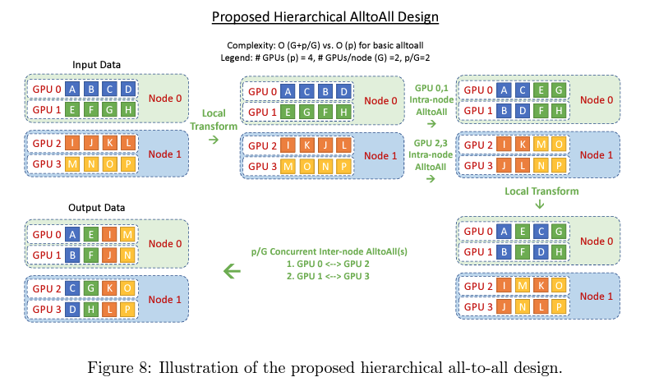
Hierarchical All-to-all
Hierarchical All-to-All
Uses a tree-based algorithm to reduce the number of communication hops.
Implemented as a two-step process:
Data-layout transformation → Intra-node All-to-All
Data-layout transformation → Inter-node All-to-All
Benefit: Reduces communication hops from O(p) to O(G + p/G), where:
G = Number of GPUs in a node.
p = Total number of GPU devices.
Latency-Bound Optimization
Despite the 2x increase in communication volume, hierarchical all-to-all allows better scaling for small batch sizes.
Optimizes latency as communication at this message size is more latency-bound than bandwidth-bound.
GRAINGER ENGINEERING
Notes:
Further the paper addresses Communication Optimizations and one is hierarchical all to all. Hierarchical All-to-All leverages a tree-based algorithm to reduce the number of communication hops, improving efficiency. It is implemented through a two-step process: first, a data-layout transformation followed by an intra-node All-to-All, and then another data-layout transformation followed by an inter-node All-to-All. This approach reduces the communication hops from O(p) to O(G + p/G), where G represents the number of GPUs in a node, and p is the total number of GPU devices. Although hierarchical All-to-All results in a 2x increase in communication volume, it still optimizes latency by enabling better scaling for small batch sizes. This is because communication at this message size tends to be more latency-bound than bandwidth-bound.

Slide 61
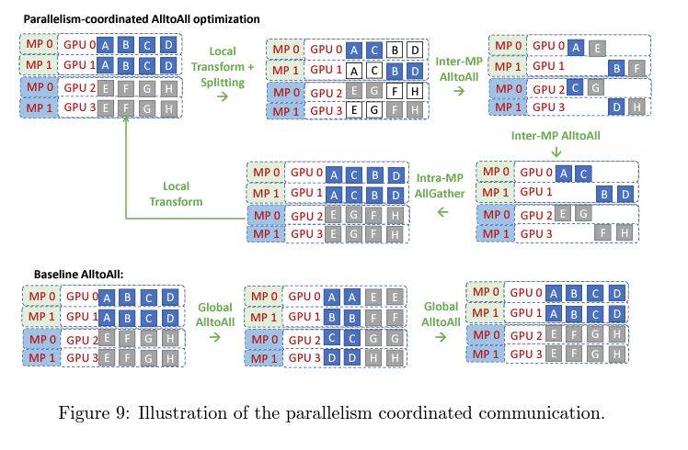
Parallelism Coordinated Communication Optimization
Challenges with Combining Parallelisms
Expert Parallelism, Tensor-slicing, and Data Parallelism:
Combining them within a single model is non-trivial
Tensor-slicing: All-reduce between split operators across GPUs.
Expert Parallelism: All-to-all communication across GPUs for expert operators.
Optimized Communication Schedule
Tensor-Slicing Before Expert Parallelism:
Replicated Data during tensor-slicing allows for optimizing
All-to-all happens within a subset of devices sharing the same tensor-slicing rank.
Latency reduced from O(p) to O(p/L), where:
L = Tensor-slicing parallelism degree.
p = Total number of GPU devices.
Expert Parallelism Before Tensor-Slicing:
Final all-to-all happens similarly, followed by an all-gather between tensor-slicing ranks.
Overall Latency: Reduced from O(p) to O(p/L) + O(L).
GRAINGER ENGINEERING
Notes:
The second communication optimization is parallelism coordinated communication. Tensor-slicing involves all-reduce operations between split operators across GPUs, while expert parallelism requires all-to-all communication across GPUs for expert operators. To address this, by performing tensor-slicing before expert parallelism, replicated data from tensor-slicing allows for more efficient all-to-all communication within a subset of devices sharing the same tensor-slicing rank. This reduces latency from O(p) to O(p/L), where L is the tensor-slicing parallelism degree and p is the total number of GPU devices. Alternatively, performing expert parallelism before tensor-slicing results in a final all-to-all operation, followed by an all-gather between tensor-slicing ranks. In this case, the overall latency is reduced from O(p) to O(p/L) + O(L), achieving a more efficient communication schedule for combined parallelisms.
Tensor-Slicing Before Expert Parallelism:
First, tensors are sliced across GPUs (tensor-slicing), which replicates data across devices.
Then, all-to-all communication is performed only within a subset of devices that share the same tensor-slicing rank, reducing the overall communication load.
This strategy decreases latency from O(p) to O(p/L), where p is the total number of GPUs and L is the degree of tensor-slicing parallelism.
Expert Parallelism Before Tensor-Slicing:
Expert parallelism is applied first, performing all-to-all communication to distribute tokens to the relevant experts.
After that, tensor-slicing is applied, followed by an all-gather operation across tensor-slicing ranks to synchronize the model’s state.
In this setup, latency is reduced to O(p/L) + O(L), balancing communication between expert parallelism and tensor-slicing.
Naïve Communication Approach
Treating each parallelism as a black box leads to sub-optimal performance.
Independent communication results in inefficient data handling between schemes.
Scaling Example (128 GPUs, 8-way Tensor-slicing, 128-way Expert Parallelism)
Latency overhead of all-to-all reduced from (128C1 + C2) to (16C1 + C2) due to 8-way tensor-slicing.
Where C1 and C2 are constants based on latency, message size, and bandwidth.

Slide 62
Highly Optimized Transformer and MoE Related Kernels
Key Optimizations for MoE Kernels
Gating Function Optimization:
Sparse Einsum replaced by dense data layout transformations.
Kernel Fusion: Gating function fused into a single kernel, reducing memory and compute overhead.
Components include:
Top-k selection: Chooses top-k experts with highest logits for each token.
Cumsum operation: Assigns token IDs to experts using parallelized Blelloch scan algorithm.
Scatter operation: Routes tokens to the correct experts.
Optimization of Einsum Operations:
Replaced sparse einsums with data layout transformations:
Sort tokens by expert ID (using mapping table).
Re-sort tokens back to original order without sparse einsum.
Reduces einsum complexity from S × E × M × ce to S × M × ce.
Results of Optimizations
Over 6x reduction in MoE Kernel-related latency.
Simplifies and accelerates gating and token sorting processes for MoE inference.
GRAINGER ENGINEERING
Notes:
The last optimization is for moe kernels. Key optimizations for MoE kernels focus on improving the gating function and einsum operations, significantly reducing latency and computational overhead. The sparse einsum has been replaced by dense data layout transformations, and kernel fusion combines the gating function into a single kernel, minimizing memory and compute demands. Additionally, the optimization of einsum operations involves replacing sparse einsums with data layout transformations, essentially reducing by another variable. These optimizations overall result in a more than 6x reduction in MoE kernel-related latency.
By sorting tokens by expert ID using a mapping table and re-sorting them back to their original order without the use of sparse einsum, the einsum complexity is reduced from S × E × M × ce to S × M × ce. These optimizations result in a more than 6x reduction in MoE kernel-related latency, simplifying and accelerating the gating and token sorting processes for MoE inference.
Transformer and MoE Kernel Optimizations
DS-MoE Inference System:
Optimized multi-GPU Transformer kernels for maximizing bandwidth in non-expert layers (DeepSpeed Inference).
Focus on MoE-Related Operators for gating and data layout transformations to reduce compute complexity.
dense operations are faster on GPUs
Optimized Data Layout Transformations:
Instead of using sparse einsum, the tokens are sorted by their expert IDs using a mapping table.
After processing, the tokens are re-sorted back to their original order, avoiding the overhead of sparse einsum operations.

Slide 63
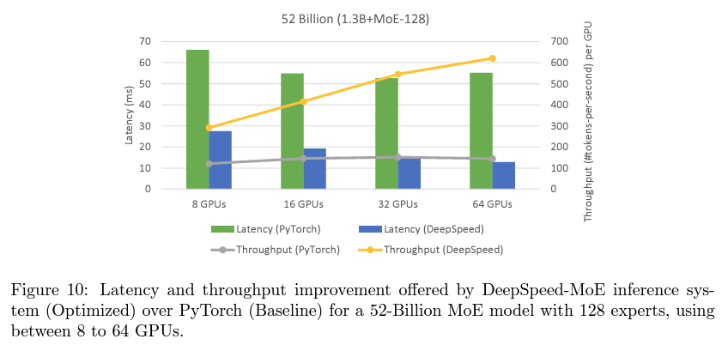
Achieving Low Latency and Super-Linear Throughput Increase Simultaneously
Dense Model Inference Challenges:
Data Parallelism: Linear throughput scaling, but no inter-GPU communication.
Tensor-Slicing (Model Parallelism):
Reduces latency but communication overhead between GPUs.
Why DeepSpeed Outperforms PyTorch?
Expert Parallelism Benefits:
As the number of GPUs increases, the number of experts per GPU decreases, improving data locality.
Each GPU reads less data from memory, enhancing performance.
DeepSpeed’s Optimizations:
Advanced communication optimizations overcome bottlenecks
Highly optimized kernels exploit reduced experts per GPU
Results:
Key Advantage of MoE: Optimize latency and throughput simultaneously while scaling.
DeepSpeed-MoE achieves super-linear throughput scaling and low latency, making it ideal for massive scaling of MoE models.
GRAINGER ENGINEERING
Notes:
Further looking at performance. Dense model inference presents several challenges with data parallelism and Tensor-slicing. DeepSpeed shown to outperform PyTorch in this context by leveraging the benefits of expert parallelism. As the number of GPUs increases, the number of experts per GPU decreases, improving data locality. This means each GPU reads less data from memory, enhancing overall performance. DeepSpeed also applies advanced communication optimizations to reduce the number of experts per GPU. As a result, as you can see in the graph deepspeed simultaneously optimizes latency and throughput as the model scales, achieving super-linear throughput scaling and low latency.

Slide 64
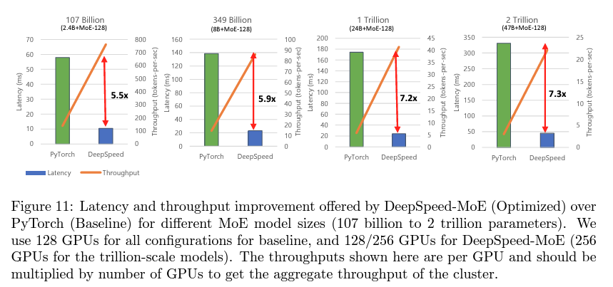
Low Latency and High Throughput at Unprecedented Scale
Exploring MoE Models
MoE models ranging from 107 billion to 2 trillion parameters.
Comparison between PyTorch and DeepSpeed-MoE.
Up to 7.3x Lower Latency and Higher Throughput compared to baseline.
Unprecedented Scale with DeepSpeed-MoE
Efficient GPU Utilization:
By leveraging hundreds of GPUs in parallel, DeepSpeed-MoE scales to massive models efficiently.
Record-breaking Performance:
A trillion-parameter MoE model can be inferenced in under 25 milliseconds.
Demonstrates incredibly low latencies at an unmatched scale.
GRAINGER ENGINEERING
Notes:
Now looking at as we scale. In exploring MoE models ranging from 107 billion to 2 trillion parameters, a comparison between PyTorch and DeepSpeed-MoE reveals significant performance improvements. DeepSpeed-MoE delivers up to 7.3x lower latency and higher throughput compared to baseline systems. It enables unprecedented scale, efficiently utilizing hundreds of GPUs in parallel to handle massive models. As shown in the graphs, With DeepSpeed-MoE, a trillion-parameter MoE model can be inferenced in under 25 milliseconds, demonstrating record-breaking performance with incredibly low latencies at an unmatched scale.

Slide 65
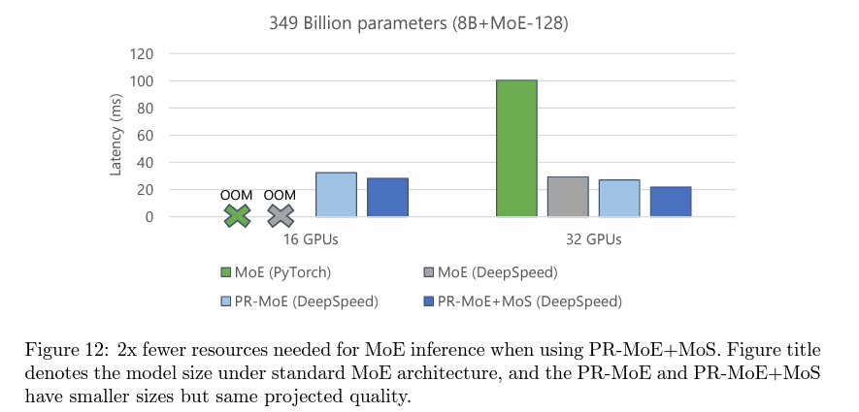
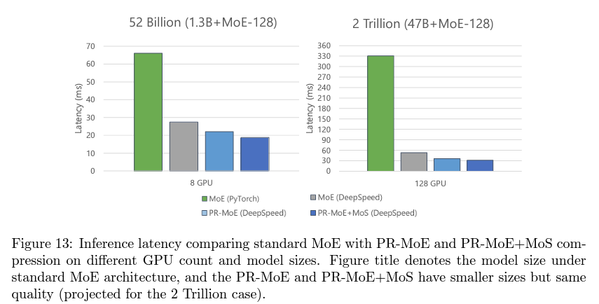
Enhanced Benefits of PR-MoE and MoS
DeepSpeed-MoE Inference System: System optimizations combined with model innovations like PR-MoE and MoS deliver significant improvements.
Reduced Minimum GPU Requirement:
Figure 12: PR-MoE+MoS allows inference with just 16 GPUs, compared to 32 GPUs for the baseline.
Improved Latency and Throughput:
Figure 13: Shows that PR-MoE+MoS offers the lowest latency and highest throughput among all model variants.
GRAINGER ENGINEERING
Notes:
Now Deep-speed-Moe combined with the PR-MoE and Mos have even more improvements. The number of minimum GPUs for inference goes down significantly which is shown on the left chart and even more latency and throughput benefits which is shown on the right chart.

Slide 66
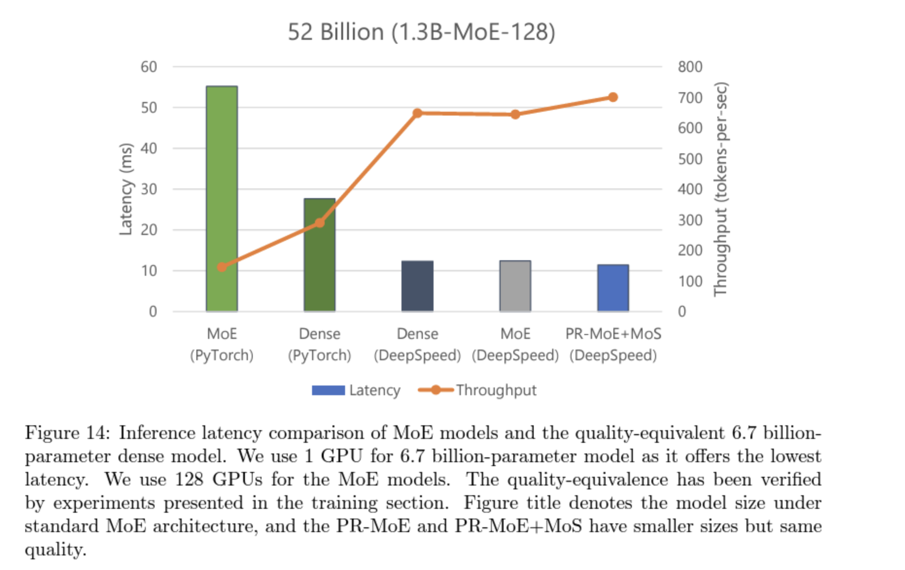
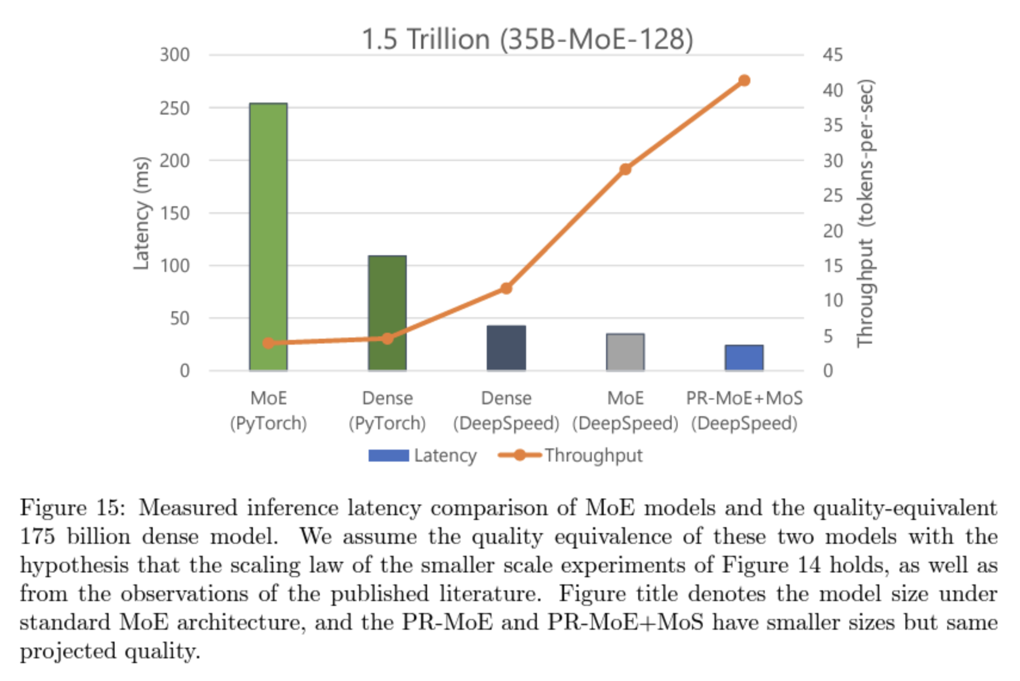
Better Latency and Throughput Than Quality-Equivalent Dense Models
GRAINGER ENGINEERING
Notes:
Futhur looking at performance, now comparing to dense models. For billion-scale models, PR-MoE+MoS is 2.4x faster and cheaper than the 6.7B dense model. At the trillion-scale, PR-MoE+MoS is 4.5x faster and 9x cheaper than the 175B dense model. MoE models scale better with DeepSpeed due to its optimized parallelism coordination, and expert-slicing allows for scaling to more GPUs than is possible with PyTorch. MoE models also benefit from using half the tensor-slicing degree of dense models, enabling 2x higher batch sizes. DeepSpeed-MoE achieves up to 4.5x faster and 9x cheaper inference compared to dense models of equivalent quality as well further showcasing its benefits. Key Results:
Billion-scale MoE: PR-MoE+MoS (DeepSpeed) is 2.4x faster and cheaper than the 6.7B dense model.
Trillion-scale MoE: PR-MoE+MoS is 4.5x faster and 9x cheaper than the 175B dense model.
Why MoE Models Scale Better with DeepSpeed
Optimized Parallelism Coordination:
Reduces communication overhead with tensor slicing for non-expert layers.
Expert-slicing allows scaling to more GPUs than PyTorch.
Higher Batch Size:
MoE models use half the tensor-slicing degree of dense models enabling 2x higher batch size.
Conclusion: DeepSpeed-MoE delivers up to 4.5x faster and 9x cheaper inference compared to quality-equivalent dense models.

Slide 67
Conclusion
Challenges with Scaling AI Models
Exponential growth of model sizes is reaching the limits of modern supercomputing hardware.
Increasing model size alone is becoming less effective due to hardware limitations.
Innovations in MoE Inference
PR-MoE Model Architecture and MoS Distillation:
Significantly reduce memory requirements.
Enable MoE models to be served at lower latency and lower cost than dense models.
MoE Inference Framework:
Delivers incredibly low latency and unprecedented scale for serving large MoE models.
GRAINGER ENGINEERING
Notes:
Two choices:
Wait for next-gen hardware.
Innovate to improve training and inference efficiency on existing hardware.
There has been limited exploration into applying MoE models in other domains such as vision, multimodal tasks, or reinforcement learning. Limited Scope: The MoE architecture, while effective in NLP tasks such as encoder-decoder models, has limited exploration in other domains, especially auto-regressive language generation models (NLG) like GPT-3. This restricts the generalizability of MoE-based models across different tasks and domains​

Slide 68
Thank You!
GRAINGER ENGINEERING

Slide 69
Other Related Work
Akul Gupta & Aditi Roy & Shraddhaa Mohan

Slide 70
Other related works
Switch Transformers: Scaling to Trillion Parameter Models with Simple and Efficient Sparsity
A big issue with large MoEs are training instability. With that in mind Switch Transformers tackle that problem by simplifying the routing algorithm and improving model specifications, delivering the first large MoE model able to be trained on the bfloat16 floating point representation. They also advanced the scale
of language models by pre-training up to trillion parameter models on the “Colossal Clean
Crawled Corpus”, and achieve a 4x speedup over the T5-XXL model.
The Switching FFN Layer:
In prior work, the minimum number of active experts in any MoE layer was two. Using at least two experts was thought to be necessary to have non-trivial gradients in the routing function. The authors propose routing each token to only a single expert—this is called a switch layer. By routing to a single expert, we
simplify the routing function,
reduce computational overhead, and
lessen communication costs while improving the model’s performance.
GRAINGER ENGINEERING

Slide 71
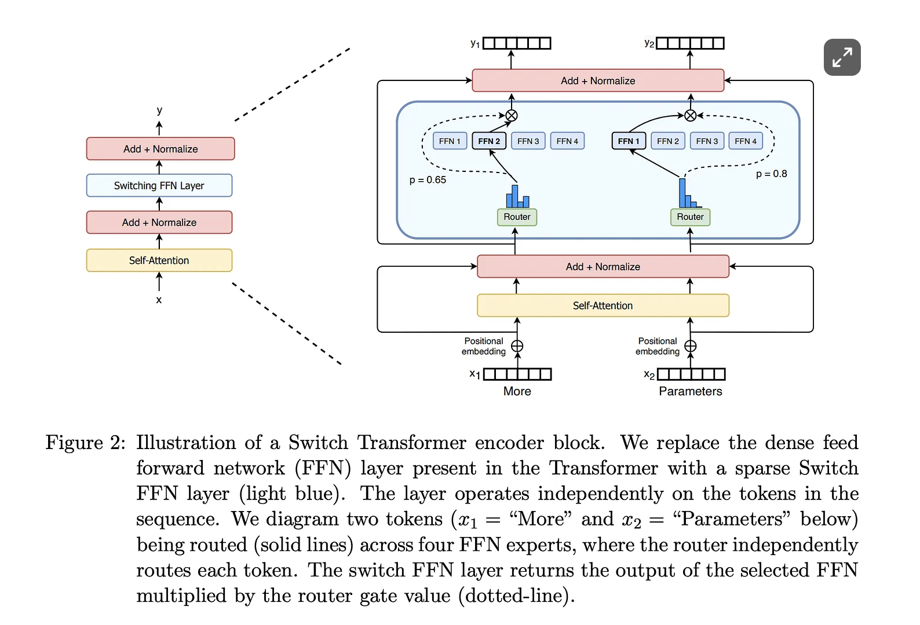
Other related works
GRAINGER ENGINEERING

Slide 72
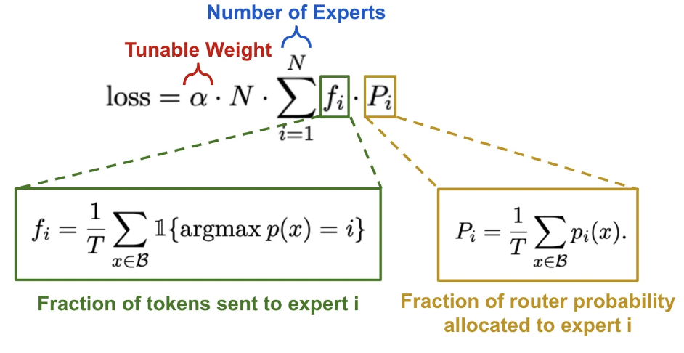
Other related works
Switch Transformers: Scaling to Trillion Parameter Models with Simple and Efficient Sparsity
Simplified Load Balancing Loss In the previous paper, authors employ multiple auxiliary loss functions to balance importance scores and perform load balancing between experts (i.e., meaning that each expert is sent a roughly equal number of tokens from the batch). In this paper we see that both of these objectives can be achieved with a single auxiliary loss function that is applied at each switch layer in the model:
This loss, which is differentiable with respect to P and can be easily incorporated into training, encourages both the fraction of tokens allocated to each expert and the fraction of router probability allocated to each expert to be 1/N, meaning that experts are equally important and receive a balanced number of tokens.
GRAINGER ENGINEERING

Slide 73
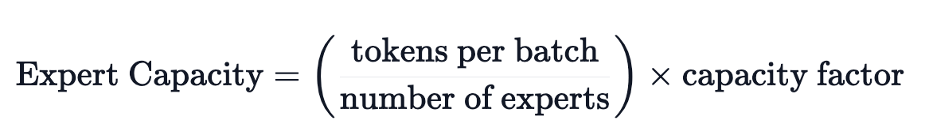
Other related works
Switch Transformers: Scaling to Trillion Parameter Models with Simple and Efficient Sparsity
Expert Capacity
Within the Switch Transformer, we set a global “expert capacity” variable that determines the maximum number of tokens that can be routed to each expert in any MoE layer.
In a switch layer, each token is routed to the expert that is assigned the highest probability by the routing mechanism. If too many tokens (i.e., exceeding the expert capacity) are sent to a single expert, computation for these tokens will be skipped. The expert capacity must be tuned to avoid having too many dropped tokens—the load balancing loss can also help with this by evenly routing tokens to experts—while not wasting computation or memory. Beyond the Switch Transformer, the capacity factor is an important hyperparameter for any MoE model that we can tune to improve hardware utilization by balancing computation across experts.
GRAINGER ENGINEERING
Notes:
These “dropped” tokens are passed directly to the next layer via the residual connection. Setting the capacity factor greater than one allows the MoE to handle cases where tokens are not perfectly balanced across experts

Slide 74
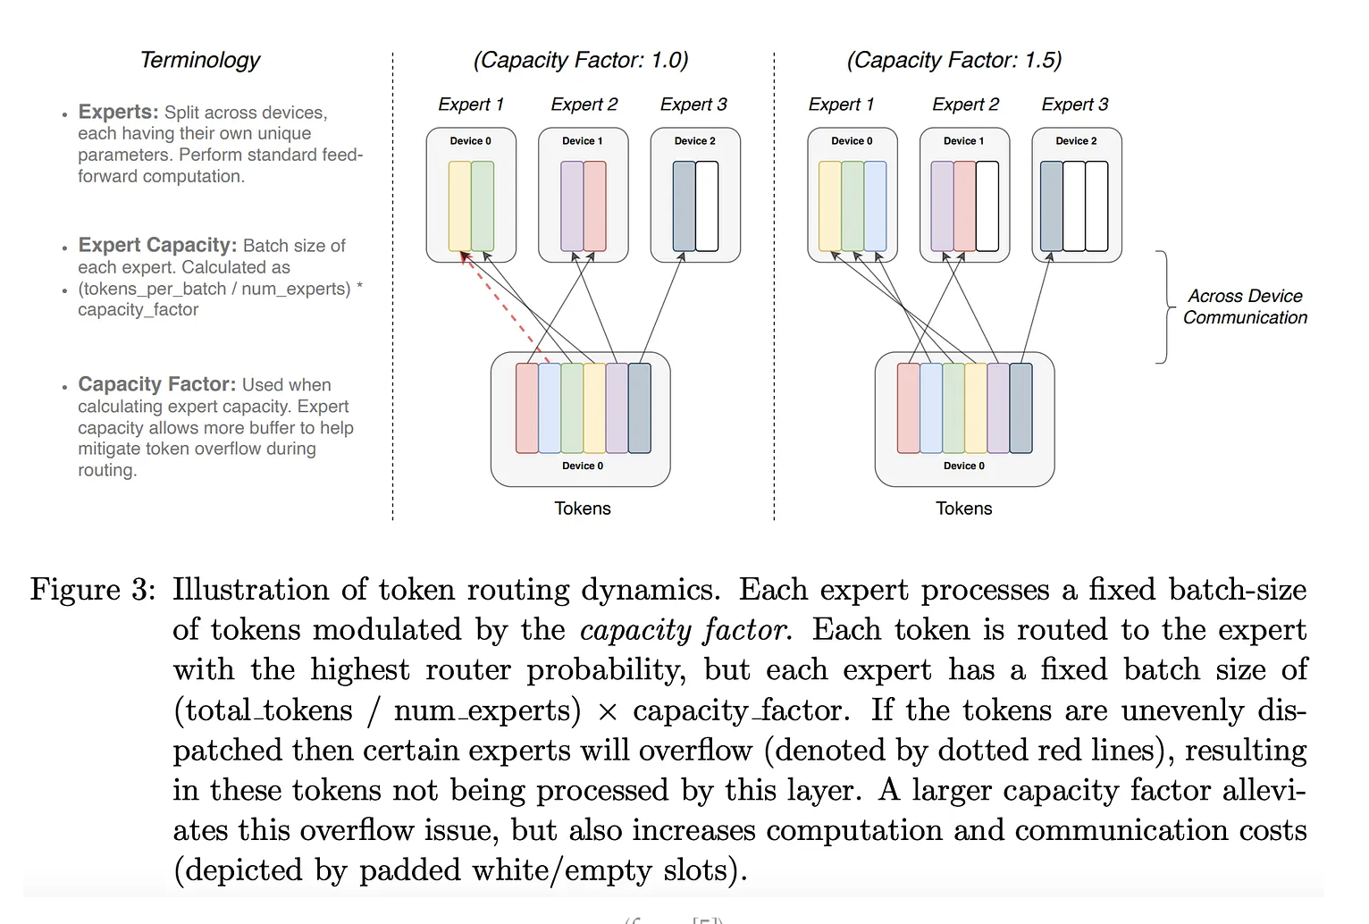
Other related works
GRAINGER ENGINEERING

Slide 75
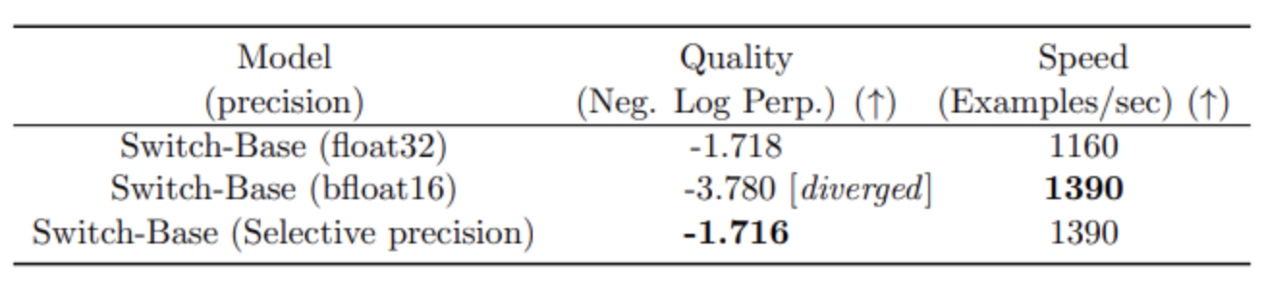
Other related works
Switch Transformers: Scaling to Trillion Parameter Models with Simple and Efficient Sparsity
Selective Precision
The authors also experiment with selective precision, such as training the experts with bfloat16 while using full precision for the rest of the computations. Lower precision
reduces communication costs between processors,
reduces computation costs, and
reduces memory for storing tensors.
The initial experiments, in which both the experts and the gate networks were trained in bfloat16,
yielded more unstable training. This was, in particular, due to the router computation: as the router has
an exponentiation function, having higher precision is important. To mitigate the instabilities, full
precision was used for the routing as well.
GRAINGER ENGINEERING
Notes:
Using selective precision does not degrade quality and enables faster models

Slide 76
Other related Work
Scaling Vision-Language Models with Sparse Mixture of Experts
This paper investigates the potential of MoEs for vision-language modeling.
They proposed a novel VLM architecture that employs MoE to scale both the text-based and vision-based feed-forward networks (T-FFN and V-FFN, respectively) in a unified framework. The approach divides the model into multiple sub-models, each of which is responsible for
processing a modal-specific subset of the input data. The text and vision input representations are then aligned via three mask data modeling objectives.
Without going into too much detail this paper contributed the following:
The first large-scale generative MoEs multimodal models for vision/langauge-only, as
well as vision-and-language tasks.
Explored various scaling strategies, including increasing dense model size, increasing expert numbers, and scaling either T-FFN or V-FFN alone, to investigate the trade-offs between model complexity and performance on various downstream tasks.
Presented ablations to understand VL-MoE model’s behavior, interpretability, and our design choices.
GRAINGER ENGINEERING

Slide 77
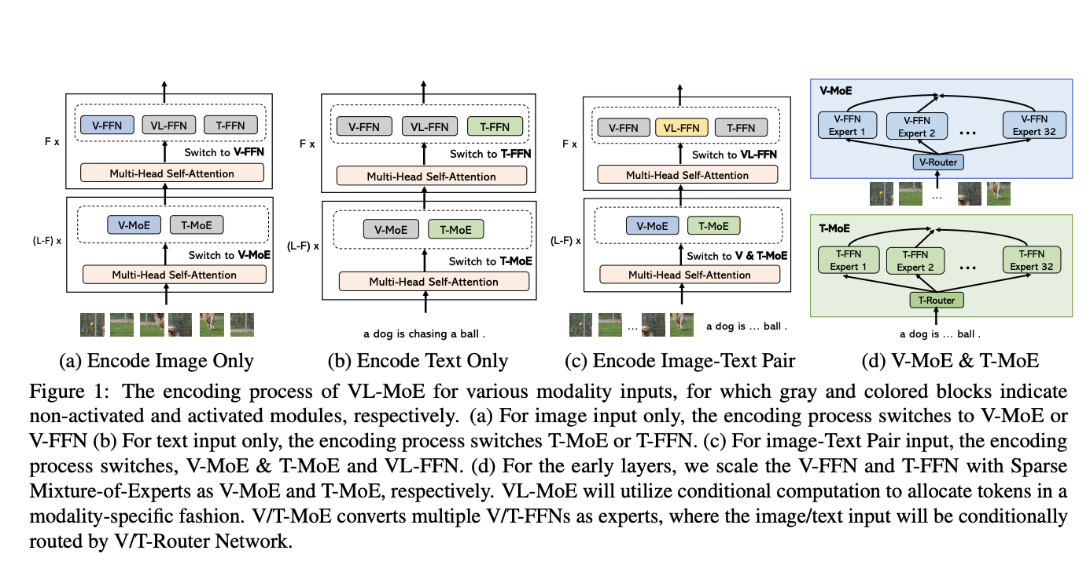
Other related Work
Scaling Vision-Language Models with Sparse Mixture of Experts
GRAINGER ENGINEERING

Slide 78
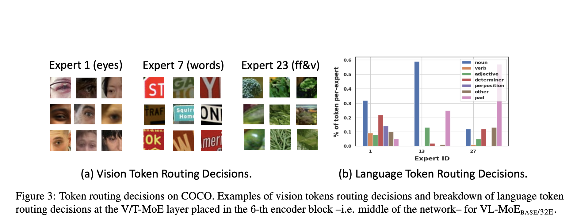
Other related Work
Scaling Vision-Language Models with Sparse Mixture of Experts
They also provide a qualitative analysis of token routing decisions on COCO. For vision tokens, their specialization is clear, as they are routed to specific experts such as food and vegetable experts, eyes experts, OCR experts, etc. On the other hand, language tokens show signs of syntax specialization, with some experts processing mostly padding tokens, while others focus on nouns and adjectives (and some padding), excluding prepositions, determiners, or verbs.
GRAINGER ENGINEERING

